Slide 1
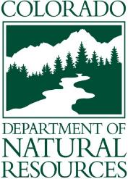

State of Colorado
ANS Program
Notes:
Introduction
Welcome to the State of Colorado’s Watercraft Inspection and Decontamination (WID) course for new Authorized Agents. The purpose of this course is to provide standardized training that prepares staff to protect the waters of our great state from harmful invasive species.

Slide 2
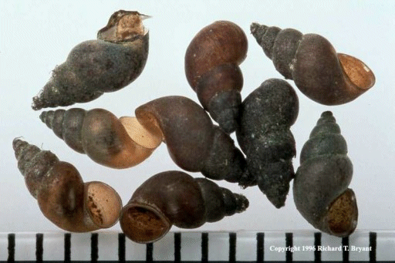
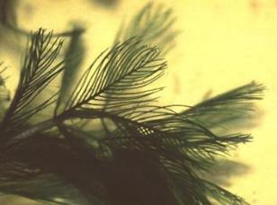
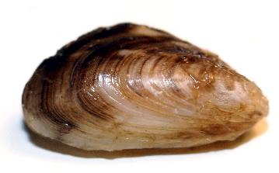
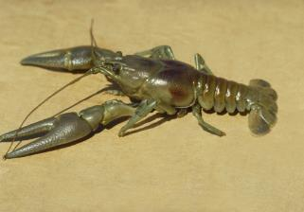
What Are Invasive Species?
Non-native plants, animals or pathogens
No natural predators outside native range
Harmful effect on natural resources and the human use of resources
Economic, Cultural and Ecological Impacts
Aquatic Invaders = Aquatic Nuisance Species = ANS
New Zealand Mudsnail Eurasian watermilfoil Zebra Mussel Rusty Crayfish
Notes:
Invasive species can be terrestrial, meaning land based, or aquatic, meaning water based. They are not native to the area and can be plants, animals, or pathogens that cause disease. Invasive species have no predators outside of their native range, and have harmful effects on natural resources and our use of those resources. They can have serious economic, cultural and ecological impacts. This course focuses on aquatic nuisance species (or ANS), since recreation boats moving over land are most likely to spread aquatic nuisance species out west.

Slide 3
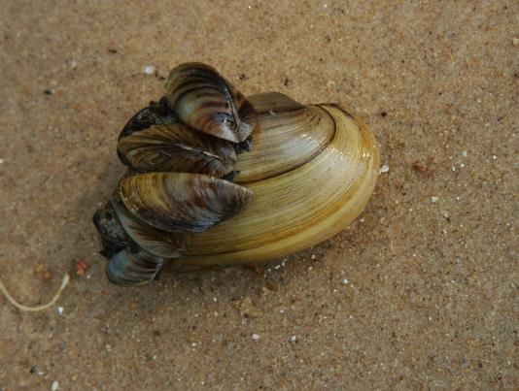
How Are ANS Defined?
Aquatic Nuisance Species means exotic or nonnative aquatic wildlife or plant species that have been determined by the commission to pose a significant threat to the aquatic resources or water infrastructure of the state.
State A.N.S. Act, SB08-226
Notes:
ANS are also defined in the Colorado State Legislature A.N.S. Act as wildlife or plant species that have been determined to pose a significant threat to the aquatic resources or water infrastructure of the state. This allows the state to identify and manage existing and new aquatic nuisance species that may enter the state.

Slide 4
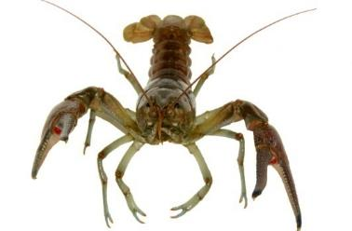
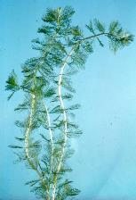
What A.N.S. Are We Concerned About?
Animals
Plants
Zebra Mussels
Quagga Mussels
New Zealand Mudsnails
Rusty Crayfish
Spiny Waterflea
Fishhook Waterflea
Asian Carp
African elodea
Brazilian egeria
Eurasian watermilfoil
Giant salvinia
Water hyacinth
Hydrilla
Parrotfeather
Yellow floating heart
Notes:
While the State Invasive Species Program’s priority is to prevent an introduction of zebra and quagga mussels, the Aquatic Nuisance Species (ANS) work is focused on all aquatic invaders that pose a potential threat to the state. The majority of Colorado’s waters have NO aquatic invasive species and we want to keep it that way!
The state of Colorado has known populations of New Zealand mudsnails, Rusty crayfish, Eurasian watermilfoil and most recently, Brazilian elodea. The ANS Program works to prevent the transportation and further distribution of these harmful invaders within the state.
There are many other ANS that are not known to be in Colorado, and we work together to prevent all these species from coming into Colorado:
Zebra and Quagga Mussels
Spiny and Fishhook Waterfleas
African Elodea
Asian Carp
Giant Salvinia
Hydrilla
Parrotfeather
And Yellow floating heart

Slide 5
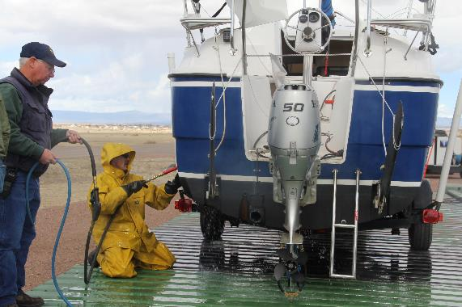

Our Mission
To Protect Wildlife, Recreation, Natural Resources, Infrastructure and the Economy by Preventing the Introduction of Zebra & Quagga Mussels, and Other Invasive Species, by Containing Current Infestations and Stopping the Spread into New Waters.
Notes:
The Mission of the Aquatic Nuisance Species (ANS) Program is, “To Protect Wildlife, Recreation, Natural Resources, Infrastructure and the Economy by Preventing the Introduction of Zebra & Quagga Mussels, and Other Invasive Species, by Containing Current Infestations and Stopping the Spread into New Waters.”
The ANS program achieves this through: WID stations, sampling for early detection and monitoring of current populations, and public educational campaigns.

Slide 6
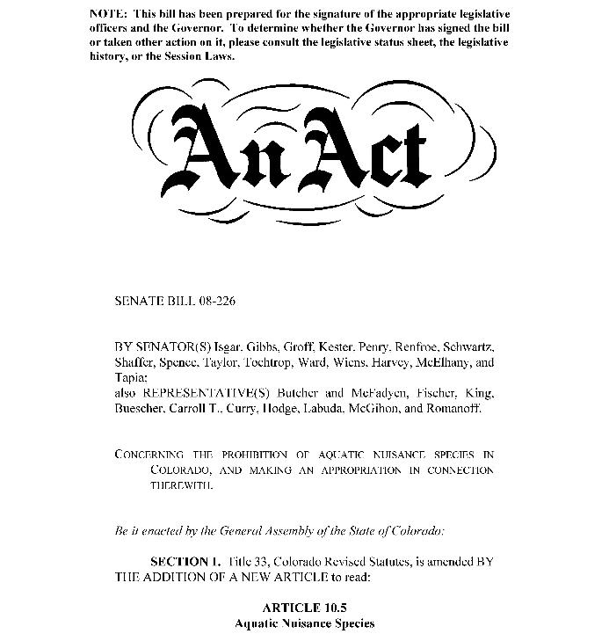
Legal Authority
Notes:
After the discovery of zebra mussel larva in Lake Pueblo January 2008, the Colorado legislature quickly passed Senate Bill 08-226, or the ANS Act in May of 2008.

Slide 7
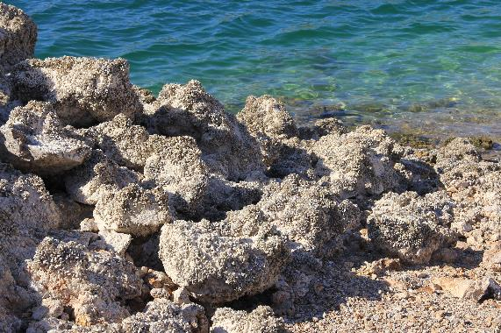
State ANS Act (SB 08-226)
Passed in May 2008
Formalized State ANS Program
Illegal to possess, import, export, ship, transport, release, plant, place, or cause an ANS to be released.
Authority to “Agents” & Qualified Peace Officers to inspect, decontaminate and watercraft for ANS.
Creates in the State Treasury an ANS Fund in both the CDOW and Parks.
  Severance Tax - $4M per year.
Notes:
The state ANS Act was passed in May 2008. This act formalized the state ANS Program.
The act made it illegal to possess, import, export shirt, transport, release, plant, place, or cause and ANS to be released.
It also provided authority for “Authorized Agents” and qualified peace officers to inspect & decontaminate watercraft for the purpose of ANS prevention. Additionally – it created the ANS fund and allocated approximately 4 million dollars per year from severance tax on the oil and gas industry.

Slide 8
Colorado ANS Act - Reporting
The Act requires that any person who knows or suspects an ANS is present (weed, animal or pathogen) must immediately report the suspect to the ANS Program.
There are three options for general reporting:
  State Program Office: 303-291-7295.
  Email: Invasive.Species@state.co.us
  Web: www.cpw.state.co.us
Notes:
All persons in the state have a duty to report per the ANS Law. If an ANS is suspected, the law requires they immediately report the ANS to CPW. This means if you find or suspect an ANS when you are not at work, like if you are out fishing or boating, you are required to report it to the state program immediately.

Slide 9
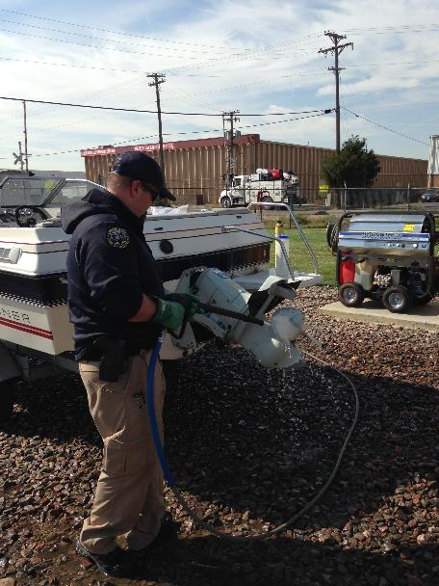
Legal Authority
“Authorized Agents”
State ANS Act (SB08-226)
“Authorized Agent” means any person, employee or representative of local, state or federal government, or any subdivision of government that is authorized by the government to temporarily stop, detain, and inspect a conveyance for ANS.
Authorizes
  Temporarily Stop and Detain Conveyance
  Inspect Conveyance for ANS
  Recommend Decontamination, if ANS are suspected
  Conduct Decontamination, if Operator is Compliant
Notes:
The Act also created “Agents” which is the legal term for an “inspector and decontaminator”
It give agents the authority to temporary stop and detain a conveyance, inspect for ANS, and recommend and perform a decontamination, if the operator is willing.
You (students) will be an authorized agent after you pass this course.

Slide 10
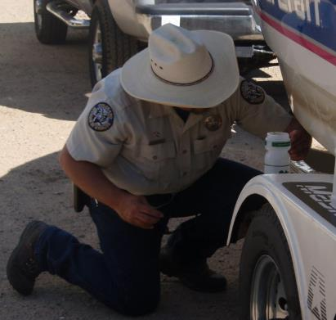
Legal Authority
“Qualified Peace Officer”
State ANS Act (SB08-226)
  “Qualified Peace Officer” means a Colorado Wildlife Officer, Special Parks Officer, or Special Wildlife Officer, a Parks Officer, a Peace Officer in the Dept. of Public Safety and a Peace Officer with jurisdiction over any waters of the State.
Authority to ORDER decontamination
Authority to IMPOUND a boat
Notes:
Qualified Peace Officers are Post Certified Officers. They can ORDER the boater to comply and impound the boat if the boater does not comply. Peace officers are only needed if the boater is noncompliant. It is rare but for those inspectors that have needed law enforcement, it’s really great to have them!

Slide 11
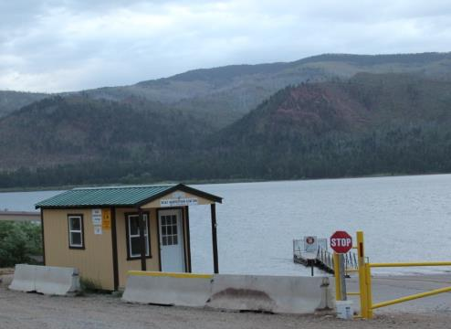
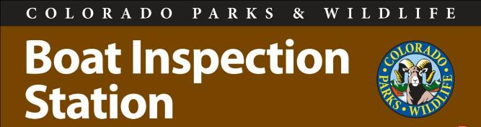
Legal Authority
“Authorized Location”
State ANS Regulations (Parks - Chapter 8 #800D)
  “Authorized location” means a location or an address where watercraft inspection and decontamination (WID) procedures are authorized and certified by the Division, and inspections are mandatory prior to launching or exiting, including, but not limited to, Division offices, government field stations, or non- governmental facilities as designated by the Division.
Notes:
The Act also provides authority to create “authorized locations” which is the location where watercraft inspection and decontamination (WID) takes place and is authorized by the state. This is where you will be working. The language was updated in regulation in January 2017 and went into effect on March 1, 2017. Changes are highlighted in red text.

Slide 12
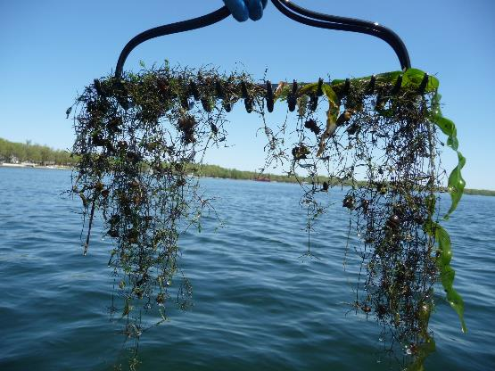
Parks – Chapter 8 ANS Regulations
Requires all persons to be trained and certified by CPW prior to performing an inspection or decontamination in the state of Colorado
Authorizes CPW to create Locations for Inspection and Decontamination
Sets ANS List
Mandates inspection and decontamination
Standards for inspection and decontamination, sampling, listing and de-listing, reporting
Notes:
ANS Regulations are covered in Chapter P-8 of Colorado parks and wildlife regulations.
These regulations require that all persons be trained and certified by CPW prior to performing inspections in Colorado. They also allow CPW to create authorized locations, set the ANS list, mandate inspection & decontamination and set the standards by which these activities will be performed.

Slide 13
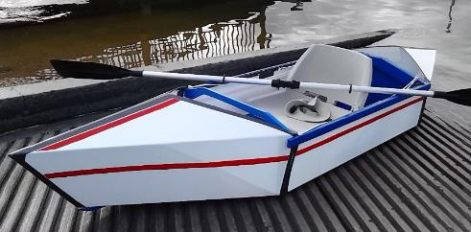
CPW ANS Regulation Updates – 2017 & 2018
Requirement for watercraft operator to…
  Clean, drain and dry the vessel in between each launch
  Remove water drain plugs upon exiting the water body
  Remove aquatic plants upon exiting the water body
  Prohibit the overland transport of a watercraft with water drain plugs in and aquatic plants attached
Amended the definition in P-800K for “Vessel or Floating Device” including “Exempt Vessels”
          The term does not include hand-launched and hand-powered rafts, kayaks, belly boats, float tubes, canoes, windsurfer boards, sail-boards, paddle boards or inner tubes or foldable plastic boats.
Notes:
In 2017, the CPW made several updates to quite outdated ANS regulations. This included updates to reflect the merger of CPW and changes in decontamination protocol since the program began. More significant chances include definitions and the requirement for all boaters to be clean, drain and dry in between each and every use. Boaters are now required to remove all plnats and water drain plugs from the watercraft upon exiting. It is now prohibited from transporting a conveyance overland with plants on board or plugs in place. This includes CPW Staff – Aquatic Biologists need to follow these new regulations too!
In 2018, the Parks and Wildlife Commission passed a citizen’s petition to change the exempt boat list in Parks Chapter 8 ANS Regulations (800-K). The Commission added the language “and hand powered” to the definition and added foldable plastic boats to the list of types of exempt watercraft. There are now 10 exempt watercraft in Colorado that do not need inspection prior to launching in state waters. Only hand-powered, non-trailered, watercraft listed here are exempt, meaning that any motor, including an electric motor, causes a craft to lose it’s exemption and now requires inspection. We will talk about this again in the third module on inspection.

Slide 14
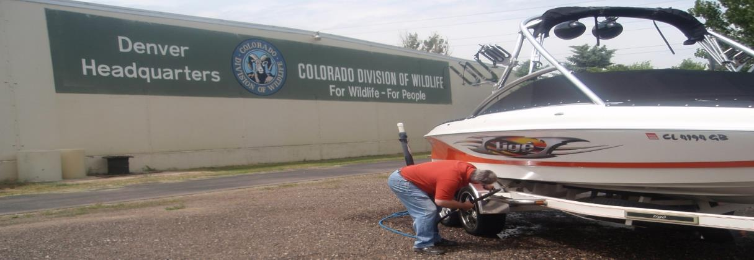
State ZQM Management Plan
Completed in 2008
Implementation Began in March 2009
Updated August 2009
Partnership Effort!
Three main parts – Sampling, WID, Education
Notes:
The WID program is a partnership based program that is still being implemented today. The Zebra and Quagga Mussel Management Plan is on the Parks and Wildlife website for anyone to view. Each Authorized Location is listed and there are site plans for each reservoir.
There are three main components of the program are sampling, WID, and education

Slide 15
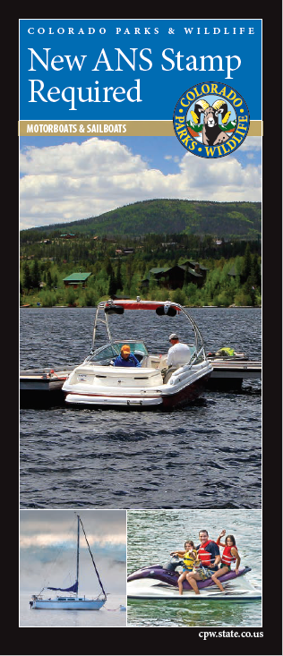
Mussel Free Colorado Act
Created ANS Stamp
Required of ALL motorboats and sailboats operating on Colorado’s waters.
    $25 for Colorado Residents
    $50 for Non-Residents
Increased penalties for ANS violations.
Allowed CPW to recover costs incurred from storage and decontamination of intercepted vessels.
Notes:
In 2018, The Mussel Free Colorado Act was passed!
This act create the ANS Stamp that is required of all motorboats and sailboats operating on Colorado’s waters starting in 2019! This stamp will come at a cost of $25 for Colorado residents and $50 for non-residents. These funds will go directly to the ANS program to assist in funding our program for years to come!
The Mussel Free Colorado Act also increased penalties for ANS related violations and also allows CPW to recover costs incurred for storage and decontamination of mussel fouled boats.

Slide 16
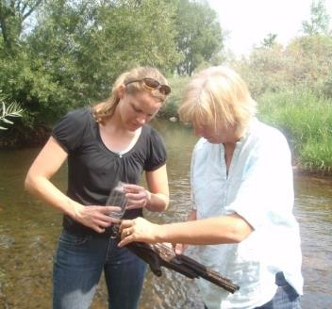
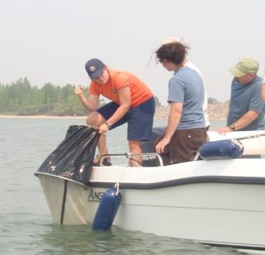
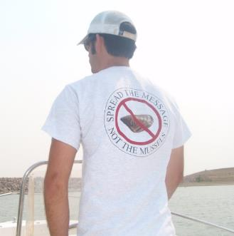
Sampling and Monitoring
Notes:
First we’ll talk about sampling and monitoring.

Slide 17
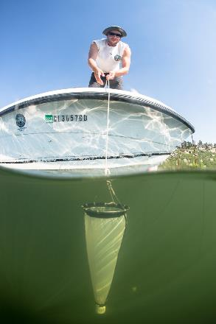
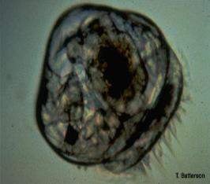
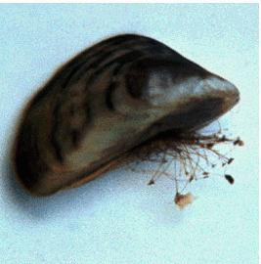
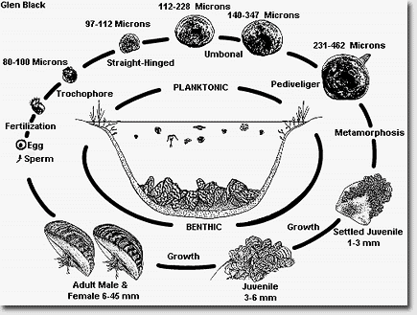
Early Detection Sampling & Monitoring
CPW Technicians
  Plankton tows
  Substrate checks
  Shoreline surveys
  Stream surveys
  Crayfish trapping
  Plant inventories
Frequency
  Risk Dependent
  1 time per year up to every 6 weeks
Notes:
ANS sampling crews monitor over 500 waters in the state. The crews follow standardized protocols that target specific life cycles of mussels. We do plankton tows to find veligers, the initial microscopic, planktonic “baby” life stage, we set out substrates to find the second life stage called “settlers” which is when the mussels begin to settle out of the water column and build shells, and last we do shoreline surveys to search for adult mussels. You will learn more about the mussel life cycle in the next module on biology. The crews also sample for crayfish, plants, and other mollusk. This year we will begin waterflea monitoring in response to detecting them for the first time in the state last year.
You will see these crews throughout the year. The frequency and quantity at which we sample is based on the risk of the water body. Please help them to get on the water fast so they can get their work done efficiently.
Trainer’s Note: You need to connect the dots for students between types of sampling and life cycle. It’s important that they get an introduction to life cycle here, in order for the detailed explanation in the next module to make sense. Second, they need to know this is about more than mussels and we are monitoring streams (which run in and out of reservoirs) and for other ANS (crayfish, plants, waterfleas, mollusks). Third, they need to know that the amount of monitoring is dependent on the risk at each reservoirs and they will see crews throughout the summer coming to monitor their lake/reservoir. Please get them on the water fast!

Slide 18
Notes:
As you can see, we focus the monitoring on plankton tows to try to find the earliest introduction of mussel possible, versus the invasion which would be too late to do anything about. We also spend considerable time doing water quality monitoring to establish the likelihood of invasion should introduction occur.

Slide 19
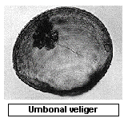

Minimum Criteria for Detection
Veligers – The following tests must all be positive on the same sample for a positive identification.
              Microscopy
              PCR
              Gene Sequencing
Settlers – Taxonomic identification by two independent experts.
Adults – Taxonomic identification by two independent experts.
Notes:
You know we sample for AIS using different methods for different life stages. Similarly, we have different standards to positively identify zebra in quagga mussels depending on the life stage (or to verify a detection of an AIS).
For veligers, or the microscopic, larval stage of mussels, the organism must first be identified under a microscope. We need to see an animal. Then we use PCR, or polymerase chain reaction, to confirm the species identification using molecular analysis or DNA analaysis. Lastly, gene sequencing is used to ensure the DNA of the species in question genetically matches zebra or quagga mussels. In order to list a water body for veligers, we have to see the animal and get positive results on two rounds of genetics to confirm there is no other animal in the world it could be!
For the settler and adult life stage of mussels, taxonomic identification must be confirmed by two independent experts. DNA analysis may or may not be required for further confirmation. The same is true of plants, mollusks and crustaceans.

Slide 20

Regional USA Language
Negative - sampling/testing is ongoing and nothing has been detected, or nothing has been detected within the time frames for de-listing.
Inconclusive (temporary status) - Water body has not met the minimum criteria for detection.
Suspect – Water body that has met the minimum criteria for detection.
Positive – Multiple (2 or more) subsequent sampling events that meet the minimum criteria for detection.
Infested – A water body that has an established population.
Notes:
In August 2013, the western states gathered in Denver and agreed on the regional language and water body definitions for AIS detected waters. Colorado adopted this language in January 2014, along with other states.
There have been NO adults detected in Colorado’s water bodies to date. We have only found veligers or DNA in Colorado.
Most waters in Colorado are negative, and therefore operate as prevention waters.
Inconclusive means there has been an exposure to mussels but actual organisms have not been found, only environmental DNA. There are no inconclusive waters in Colorado.
Suspect means that a water has met the minimum criteria for detection only once. Green Mountain Reservoir had a single veliger detection in August 2017 and is currently considered suspect.
Positive means that a water has met the minimum criteria for detection more than once.
As of January 2017, there are NO zebra or quagga mussel positive waters in Colorado!
Infested means there is an adult reproducing population in the water body. There has never been an infested water body in Colorado. We are surrounded by infested waters – Kansas, Nebraska, South Dakota, Montana, Utah, Texas, Arizona, California, Nevada, everything East of Colorado!

Slide 21

Regional De-Listing Protocol
Positive
    5 years of negative testing
Negative
Notes:
Colorado adopted the western regional standard for de-listing waters for zebra and quagga mussels in 2014. Per this regional standard, a water which has tested positive for zebra or quagga mussels must go through five subsequent years of negative testing to go from a positive to a negative status.

Slide 22
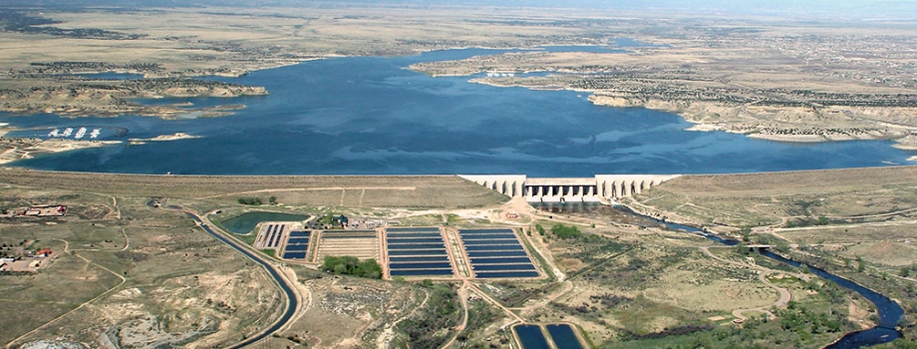
De-Listing Colorado’s Waters
January 2014 – Colorado de-listed Blue Mesa, Jumbo, Grand Lake, Granby, Shadow Mountain and Tarryall Reservoirs after five years of no detection.
January 2017 – Five years since previous detections for mussels. Per regional standards, Pueblo is no longer considered positive for quagga mussels.
CPW has stopped the continued inoculation of our waters with mussels through the mandatory boat inspection and decontamination program. The ANS Program works!
Notes:
Per the regional standard, Colorado delisted Grand Lake, Granby Reservoir, Shadow Mountain Reservoir, Willow Creek Reservoir, Jumbo Reservoir, Tarryall Reservoir after five years of negative testing. These reservoirs all had a single veliger detection in 2008, and no detections since.
Blue Mesa Reservoir was also de-listed from suspect to negative in 2014. Only eDNA has ever been found in Blue Mesa, and none in 2013.
In January of 2017 Colorado also de-listed Pueblo reservoir after 5 years of negative testing!
Trainer’s Note: Colorado and Utah have both delisted waters in adoption of the new regional standard. Utah delisted first.

Slide 23
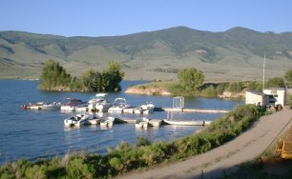
Green Mountain Reservoir
12 veligers detected in BOR tow nets samples near the dam
Quagga mussel veligers (larval stage) confirmed on 8/25/17
Considered a “Suspect” ANS water
  No adults have been found at GMR.
  Second independent sample and confirmation of Quagga mussel veligers needed to be declared a “Positive” ANS water.
Enacted containment protocol on 8/26/17
Notes:
While CPW started 2017 with a historical change from positive to negative status; in August CPW declared Green Mountain Reservoir “suspect” for quagga mussels and wound up right back in containment mode. Green Mountain is a BOR owned and under the recreational management of the White River National Forest. Green Mountain is operated as storage for the Upper Colorado River Collection System and has a hydropower plant. Green Mountain is a popular Summit County destination for boaters. Green Mountain will continue to operate the WID Station there in containment mode for the 2019 boating season.

Slide 24
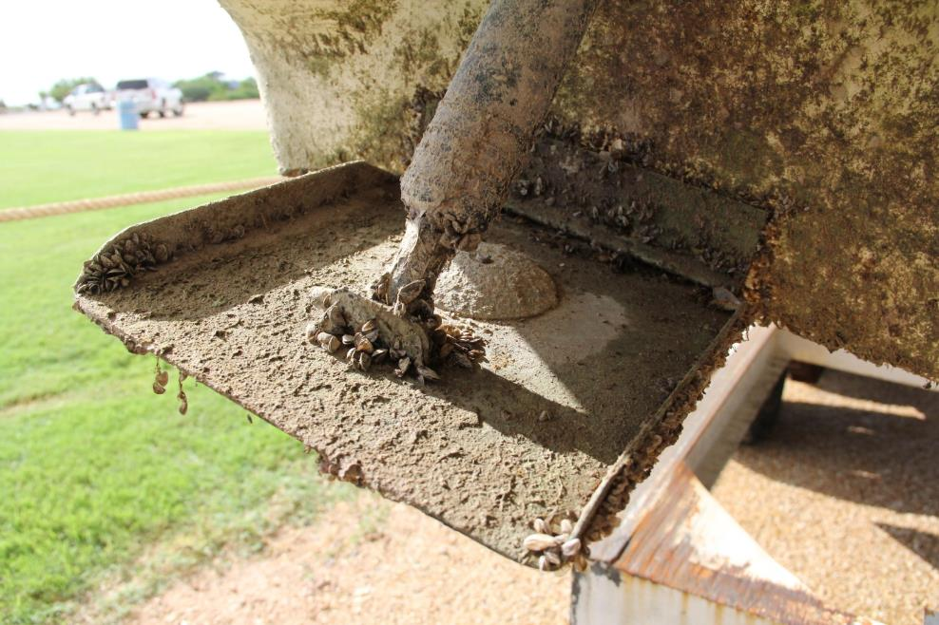
Watercraft Inspection & Decontamination (W.I.D.)

Slide 25
Mandatory Inspection Regulations
Resident Boats
The boat must pass a state-certified boat inspection if:
  The boat has launched in waters outside of Colorado.
  The boat has launched on any positive waters in Colorado. You must submit the boat to an inspection for ANS prior to leaving the containment body of water.
  Any reservoir where inspections are required (Prevention).
Out-of-State Boats
The boat must pass a state-certified ANS inspection if launching in any Colorado lake, reservoir or waterway.
Notes:
Moving onto watercraft inspection and decontamination. Colorado is a mandatory inspection state. That means that your boat has to be inspected before launching in waters of the state, according to state law, if the watercraft has been launched out of state, is leaving an ANS positive water within the state, or before launching anywhere the owner or manager requires it (prevention – majority of our WIDS).
All out of state boats must pass a state certified inspection before launching on any Colorado water body.

Slide 26
Types of WIDS
Negative Prevention Water - Waters that have never had a verified detection of any ANS, or have been de-listed.
Other ANS Positive Water – Waters that have a verified presence of an ANS listed in Chapter 8 regulations other than zebra or quagga mussels.
    Most ANS Positive waters are also prevention waters for mussels and some other ANS.
ZQM Containment Water – Waters that have had a verified zebra or quagga mussel detection.
Off Water WIDS – Authorized Locations that are not at a lake or reservoir (e.g. offices or marine dealers)
Notes:
There are four different types of WID Stations.
- Read slide -

Slide 27
WID Authorized Locations
Number of Authorized Locations by Entity
Entity Type | ‘08 | ‘09 | ‘10 | ‘11 | ‘12 | ‘13 | ‘14 | ‘15 | ‘16 | ‘17 | ’18
Colorado Parks & Wildlife |  |  |  |  | 38 | 37 | 37 | 32 | 32 | 30 | 29
State Parks | 24 | 28 | 28 | 28
Division of Wildlife | 5 | 160 | 19 | 19
Larimer County | 0 | 2 | 2 | 2 | 2 | 2 | 2 | 2 | 2 | 3 | 2
Municipalities | 3 | 7 | 11 | 9 | 8 | 8 | 8 | 8 | 8 | 7 | 8
National Park Service | 0 | 1 | 1 | 1 | 1 | 1 | 1 | 1 | 1 | 1 | 1
Private Industry | 3 | 11 | 51 | 30 | 24 | 27 | 27 | 28 | 28 | 31 | 32
Total: | 35 | 209 | 112 | 89 | 73 | 74 | 75 | 71 | 71 | 72 | 72
76
Notes:
There are just over 70 WID stations operated by a variety of jurisdictions in Colorado. The majority of which are operated by CPW and industry.
This is a partnership effort. CPW does not own very much water in Colorado.

Slide 28
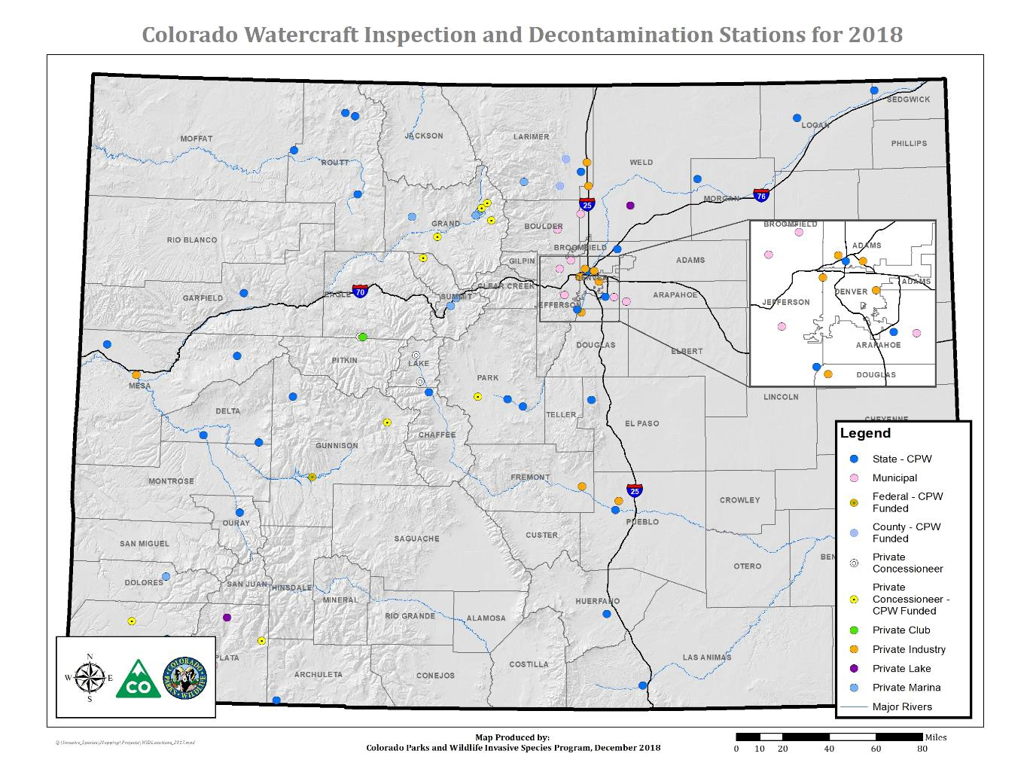
Notes:
This map shows the distribution of inspection stations across the state. As you can see, we have stations corner to corner. In Colorado, a boater should never be too far from an inspection station to comply with the mandatory regulations. There are many partners involved – private industry, federal government, cities, counties and of course, CPW.

Slide 29
Statewide Inspection Numbers
Over 4.4 Million Inspections!
Notes:
Colorado leads the nation in the number of boat inspections performed. As you can see, the inspection numbers come to about 400,000 per year, including entrance and exit inspections. In total, the state has collectively performed over 4.4 million inspections and 90,000 decontaminations since 2008.

Slide 30
Statewide Decontamination Numbers
Notes:
It’s important to note that there is a large increase in the number of decontaminations performed each year. This is a direct result of CPW and their partners adapting to mitigate new threats. Recent research publications indicate zebra or quagga mussel veligers can survive up to 27 days in standing water on watercraft. Another factor increasing Colorado’s need for decontamination is the increase in mussel infested waters in other states, including Lake Powell and some northern Texas reservoirs. Lastly, waters in close proximity to, or positive for, other ANS, such as NZMS or EWM, perform more decontaminations to limit their spread in state. CPW and their partners revised mandatory standing water decontamination triggers in 2013 to reduce the threat of invasion from viable zebra or quagga mussel veligers living in standing water, to protect against watercraft coming from other state’s infested waters and to reduce the spread of other invasive species.
Trainer’s Notes: It is very important to explain that there are three reasons why standing water decons increased in 2012-2019: (1) increase in ZQM infested waters in neighboring states (2) increase in other ANS positive waters in Colorado and (3) new science says that veligers are hardier than previously thought and can live up to 27 days in standing water on boats.

Slide 31
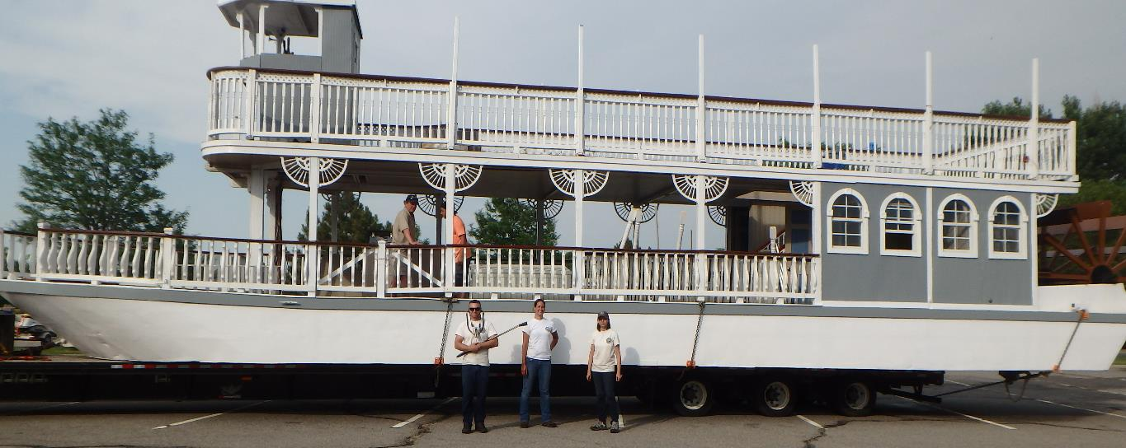
Infested Mussel Boat Interceptions
Notes:
Staff at Colorado’s network of watercraft inspection and decontamination station routinely intercept watercraft infested with zebra or quagga mussels, or other suspect ANS. It is obvious that recreational watercraft is the main pathway of spread and invasion for zebra and quagga mussels to move overland and infest new watersheds.

Slide 32
Mussel Boats Intercepted by Entity
Notes:
There have been 195 mussel boat interceptions since the program began. All of these boats were coming in from out of state and were fully decontaminated before being allowed to launch.

Slide 33
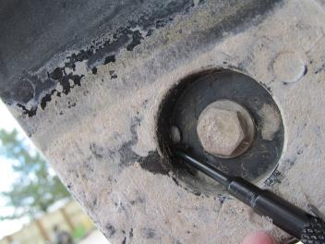
195 Total Interceptions 2009-2018
Pueblo (45)
Horsetooth (30)
Blue Mesa (16)
6060 Broadway (15)
Chatfield (13)
Highline (8)
Cherry Creek (7)
Sweitzer (7)
Carter (5)
Eleven Mile (4)
Ridgway (4)
SW Colorado (5)
Granby (3)
Great Lakes Marine (3)
Boulder Reservoir (2)
Boyd Lake (2)
Crawford (2)
Dillon (3)
Frisco Bay (2)
Lathrop (2)
Navajo State Park (2)
North Sterling (2)
Ruedi (2)
Vallecito (2)
Barr Lake
Boulder Marine
Canon Marine
Clear Creek
Grand Junction
Grand Lake
Jackson
McPhee
Shadow Mountain
Stagecoach
Steamboat Lake
Strontia Springs
Taylor Park
Turquoise Lake
Williams Fork
Notes:
Pueblo has by far the most interceptions with 45, Horsetooth is second with 30 and Blue Mesa is 3rd with 16. Those are three of the busiest reservoirs in Colorado. But, it’s not just the heavy lifters that get mussel boats – we have had interceptions in all 4 regions at very large and very small reservoirs operated by all jurisdictions.
Trainer’s Note: Sites listed on the right side have had 1 interception to date.

Slide 34
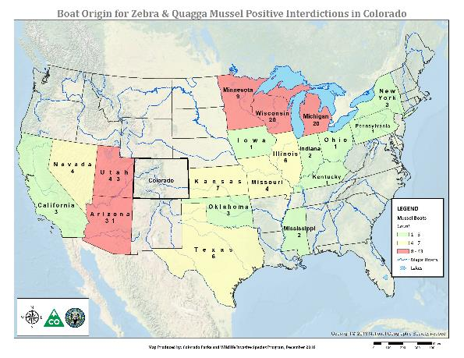
Mussel Boat Origins 2009-2018
Mississippi
Missouri
New York
Nevada
Oklahoma
Ohio
Pennsylvania
Texas
Wisconsin
14 are Unknown
Great Lakes
Arizona
California
Illinois
Indiana
Kansas
Kentucky
Louisiana
Michigan
Minnesota
Notes:
And the mussel boats are coming from all directions! We have intercepted boats from all across the country. The reason 14 are unknown is because those boats were in so many infested waters traveling across the country, that we couldn’t pin down where the mussels were from. Colorado is truly surrounded by infested waters, but we have the tools to prevent those infested boats from getting into our waters and we can keep our waters clean!

Slide 35
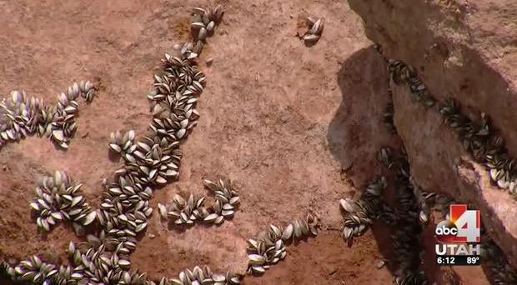
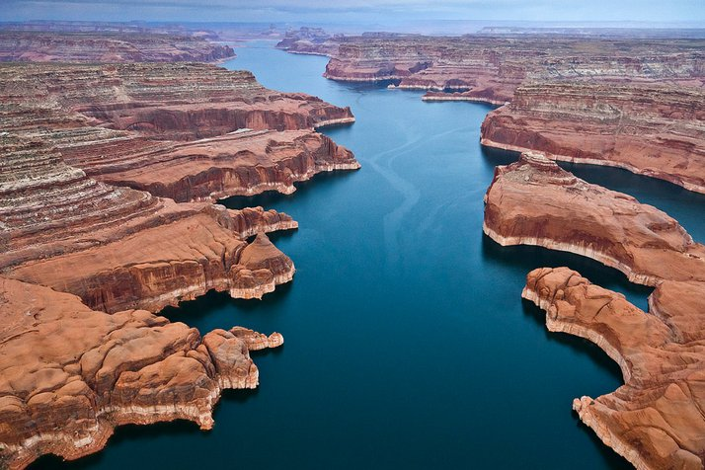
Lake Powell – A Game Changer
Notes:
Lake Powell – a new threat that is growing faster than ever!

Slide 36
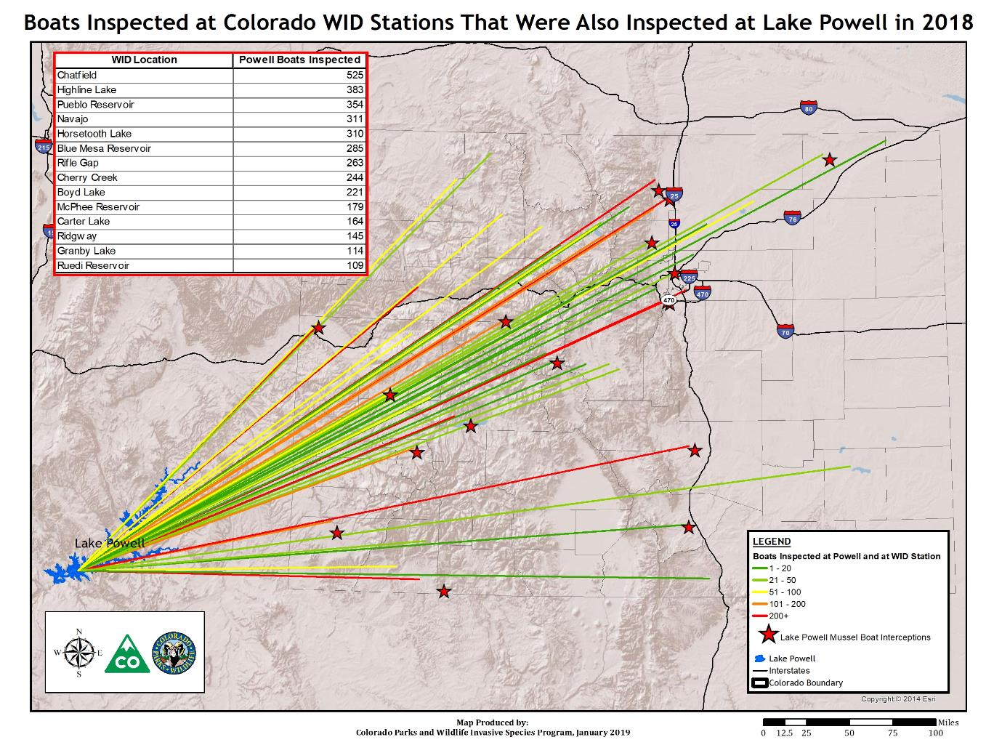
Notes:
This is a statewide problem. We’ve seen mussel boats all across the state. And Lake Powell is only ONE infested reservoir that we have to worry about. Since we started… many states have turned up positive while we are going negative! We are surrounded by mussel infested waters!

Slide 37
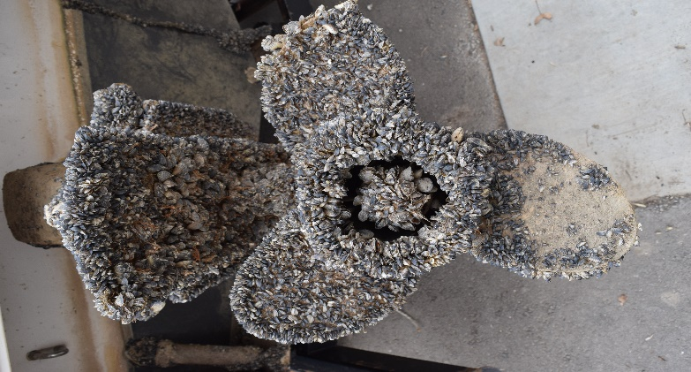
Mussel Boat Origins 2018
Lake Powell – 40
Michigan– 3
Arizona – 2
Minnesota – 2
Missouri - 1
Pennsylvania – 1
Illinois – 1
Kansas - 1
Notes:
In 2018 –Low water levels and a booming mussel population contributed to a very challenging situation at Lake Powell. 40 of the 51 mussel fouled watercraft intercepted in Colorado in 2018 originated from Lake Powell.
The states of Utah & Arizona as well as the National Park Service are working very hard to increase containment efforts at Lake Powell.

Slide 38
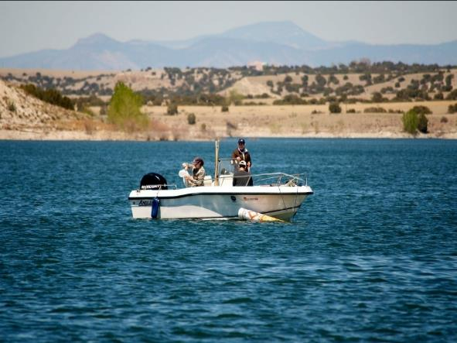
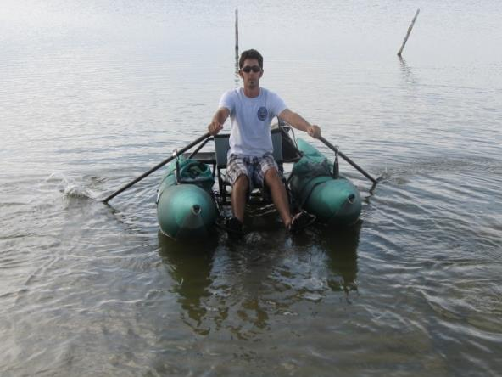
QC, Biologists, Hatcheries, Researchers
Notes:
Let’s chat about a few other CPW operations….

Slide 39
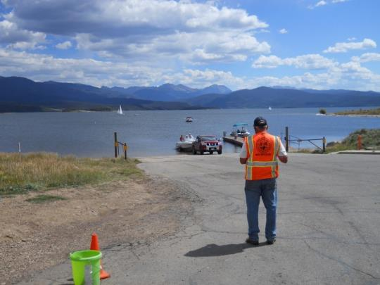
Quality Assurance
  Required in ANS Regulations.
  Ensure consistency of implementation of WID Protocols across jurisdictions.
  Provide support to field stations.
Notes:
It is required in regulation that the ANS Program conduct quality control evaluations to ensure that stations are following protocol and providing protection to those lakes. This includes secret shopping of inspection stations, on the job training and evaluation of customer service representatives throughout the state. The intention of quality assurance is to help. The intent is to improve inspections and decontaminations, and ultimately provide the highest protection of our resources and recreational opportunities. You must score 70% or better to pass QA. The evaluations are based on the inspection procedure we will cover later today so be sure to learn and practice them well! You will also use the QA form when practicing inspections in class.

Slide 40
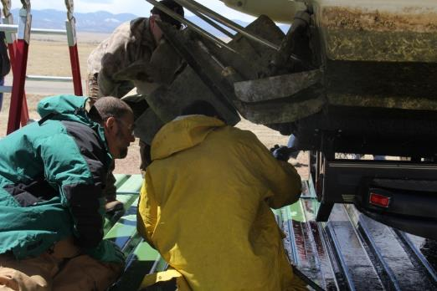
Quality Assurance
Types:
  Secret Shopper Evaluations
  Announced Visits
  On the Job Training
  Customer Service Evaluations
  Data Review
  Active Management by Supervisors or Program
    Checking Data Entry
    Assisting staff with inspections or decontaminations
Notes:
It is required in regulation that the ANS Program conduct quality control evaluations to ensure that stations are following protocol and providing protection to those lakes. This includes secret shopping of inspection stations, on the job training and evaluation of customer service representatives throughout the state. The intention of quality assurance is to help. The intent is to improve inspections and decontaminations, and ultimately provide the highest protection of our resources and recreational opportunities. You must score 70% or better to pass QA. The evaluations are based on the inspection procedure we will cover later today so be sure to learn and practice them well! You will also use the QA form when practicing inspections in class.

Slide 41
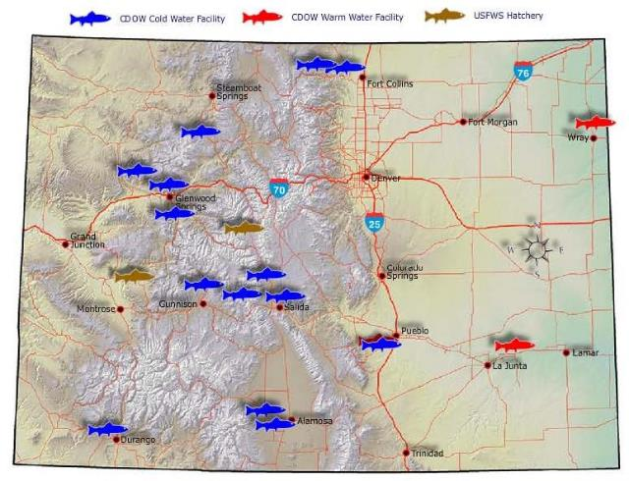
State Fish Hatchery Units
Annual Fish Health Inspections
Hazard Analysis and Critical Control Point Planning
Preventative Measures
  Wild Spawn & Fish/Egg Transfer
Notes:
Hatcheries in Colorado are required to do annual fish health inspections and have protocols in place specific to the facilities and fish transport to prevent the spread of fish diseases and invasive species. They are regularly monitored for ANS and to date, NO mussels have been found in a Colorado hatchery but protections are in place so that CPW has the highest assurance of risk mitigation just in case. We try to set the example and do the maximum protection possible.

Slide 42
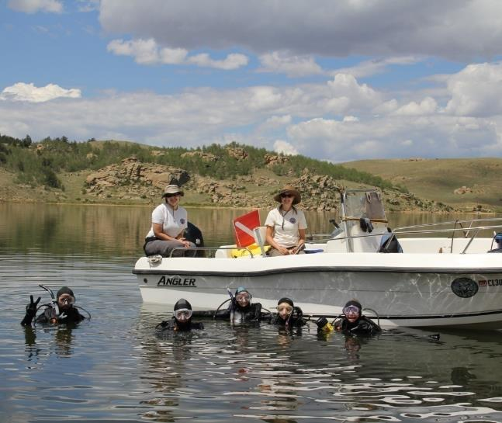
ANS Crews & Aquatic Biologists
Boats and all field equipment must be decontaminated in between each use
Biologists have their own decontamination unit
They should be green sealed with receipt
HAACP for Biologists
Notes:
You may see ANS sampling crews and aquatic biologists from time to time at reservoirs or on the inspection ramps. Every member is certified to do their own inspections and decontaminations. They fully decontaminate all their equipment and boats in between each and every use. They will be green sealed with a receipt. You will see the protocol in the inspection module under the green seal section. While they do have to stop to have inspectors verify their seal and receipt, please do not hold them up on the ramps. They are being paid with ANS Funds, same as you, to sample and monitor your lake or reservoir and the most efficient use of those resources is to get them on the water fast. It is a waste of state resources to have them sitting in line waiting to launch their boat, after we just paid them to decontaminate their boat. We greatly appreciate inspectors quickly moving them through and getting them onto the water as fast as possible.
Trainer’s Note: Encourage students to get these boats on the water fast for the most efficient use of CPW ANS Funds. We do not want to waste money paying people to sit in line to launch.

Slide 43
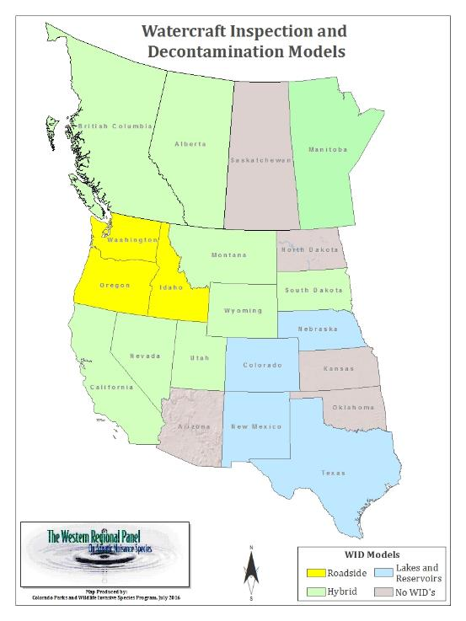
Western State Programs
All states and provinces in the West now have ANS Programs.
Many are still unfunded or underfunded.
All are understaffed.
Western states and provinces are connected and helping each other.
Notes:
All western states have ANS programs. Some have very sophisticated boat inspection systems similar to Colorado. However, many states are unfunded or underfunded and almost all lack personnel needed to run inspection stations. While there are many challenges ahead for other states and the region, western states are working together to find some common solutions and create a system of reciprocity between western states. We are connected and we are helping each other!
Trainer’s Note: This program is about more than one lake, in fact, it is about more than one state. The west is working together to stop mussel movement and Colorado is leading the way!

Slide 44
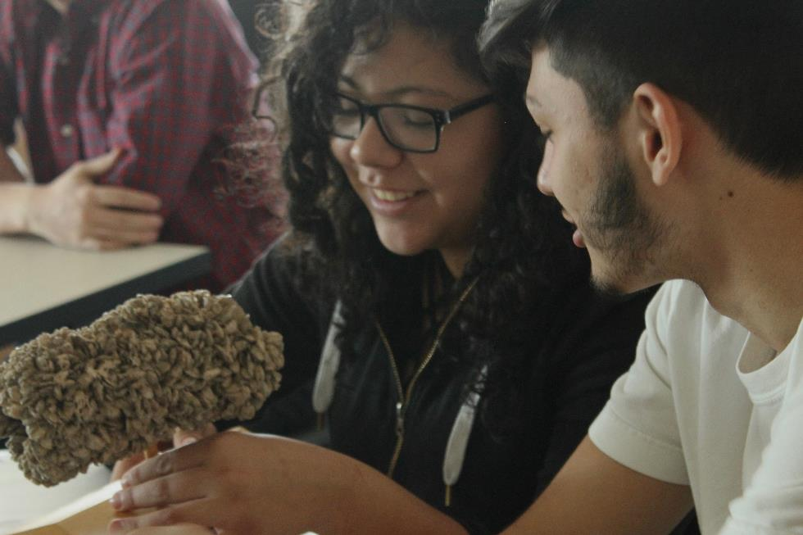
Priority #1 - Education!
Notes:
Finally, let’s discuss one of the most important aspects of our program – education and outreach!

Slide 45
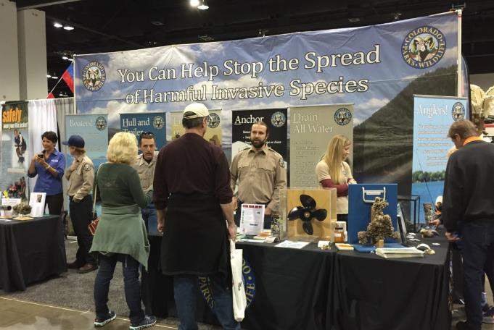
Education IS the Most Important Thing!
We can’t be on every water body all the time.
If each boater, angler and professional clean their boats and gear in between uses, we will stop the spread of ANS.
Consistency in messaging is key.
Notes:
As an inspector, your primary objecting is to educate boaters and anglers to clean and dry their boats and gear in between uses. Colorado will never have the resources to perform inspections on every body of water, 24 hours a day, 7 days a week.
Research has shown that using the “authority of the resource”, or making one understand their impacts on the environment, is the most successful way to change negative behavior. If boaters and anglers understand that transporting ANS will cause harm to their favorite fishing and boating spots, they are more likely to clean their boats and gear, and transport them cleaned, drained and dry every day.

Slide 46
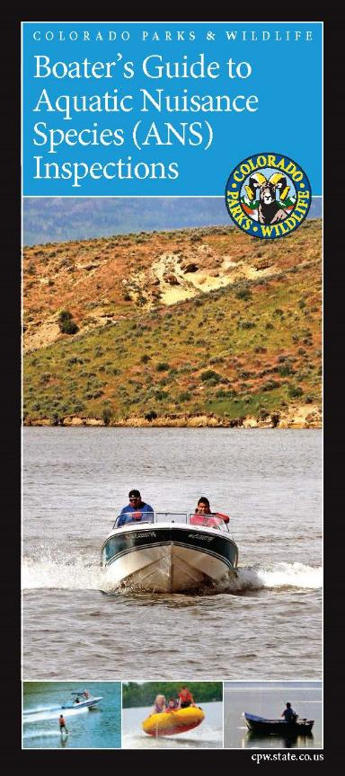
Education = Priority #1
Each inspection is a face to face educational contact.
CPW trains 700 inspectors per year…
YOU train 86,000 boaters per year through… 450,000+ inspections per year!
Clean, Drain, Dry!
  No Water, No Mud, No Plants, No Mussels!
Boaters NEED to know how to do this themselves when they boat at waters without inspections.
Notes:
The state of Colorado trains about 700 inspectors a year. Inspectors train close to 90,000 registered boaters, not including out of state boaters, through the performance of over 400,000 inspections per year! In doing so, YOU are teaching the boaters to clean, drain and dry. YOU are teaching boaters not to transport standing water. We are changing the culture of boating. If there is no water, no mud, no plants and no animals, we are significantly reducing the risk of transporting invasive species.

Slide 47

Educational Materials
Handouts
  ANS Program Fact Sheet
  Stop the Spread of ANS
  Ballast Boats
  Live Aquatic Bait
  Mussel Boat Interceptions
  Risk Assessment
  Economic Impacts
Brochures
  Audience
  Boaters Guide
  Zap the Zebra
Rack Cards
  Anglers
  Scuba Divers
  Green (Spanish)
Guide Books
  ANS Pocket Guide
  Mollusk Guide
Notes:
To assist you with educating the public, we have lots of educational materials for your use. The program office develops these to meet the needs of the field.
47

Slide 48
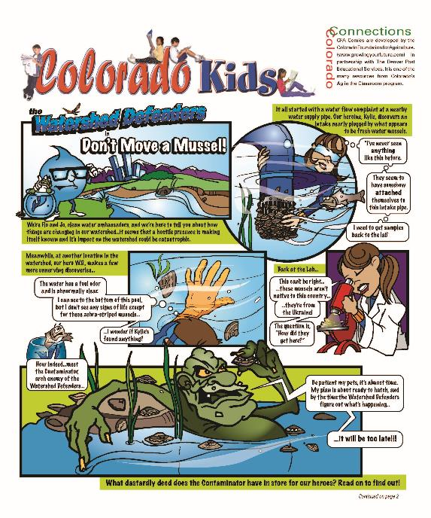
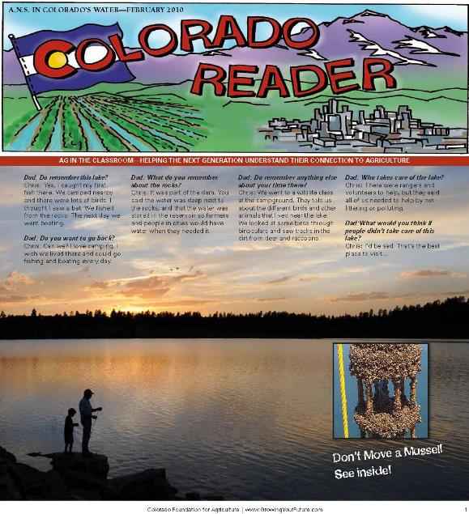
Youth Education
Notes:
Educate YOUTH! Kids are the future! We have comic books and newspapers that are meant for children.

Slide 49




Specific User Resources
Notes:
We also have user specific resources, such as wader and boot cleaning brushes, angler rack cards and scuba diver rack cards to educate on how to properly disinfect and clean gear. Any opportunity you have to talk with anglers about cleaning gear is time well spent – and who doesn’t love a free brush?

Slide 50

ANS Pocket Guide
Professional Education Tool
Summary of Program and Laws
Species Accounts for Animals, Plants, Fish and Pathogens
Status and Reporting
Notes:
Each inspector will be given an Aquatic Nuisance Species Pocket Guide. This is a professional educational tool that puts all four prohibited ANS lists in one book for easy use and reporting.

Slide 51


Handouts!
Specific information on a topic of interest.
Available online, at inspection stations, or by request to program office.
Offers a quick and easy response to an inquiry.
Notes:
We also have handouts & Fact sheets focused on specific issues encountered on ramps and at customer service centers such as ballast boats, aquatic bait, and general invasive species information.

Slide 52

The Western Regional Panel on ANS
Western Coordination and Communications

Slide 53








Western ANS Coordination
Notes:
Western states are connected and working together across the landscape in a coordinated fashion. The Western Regional Panel on Aquatic Nuisance Species serves as the foundational coordinating body in the west. The Panel drafted the Quagga Zebra Action Plan for Western Waters (or QZAP) in 2010 at the request of Senator Feinstein and has collaborated to coordinate implementation.
Colorado has provided leadership for both the west over the years. An example of a mutually beneficial outcome is the Western Regional Data Sharing System for Watercraft Inspection and Decontamination Stations. Following two years of collaborative scoping by western states, Colorado modified our state database and made it available for use by any authorized entity in the West. For the past few years, Colorado has received federal grants to pay for the ongoing annual operations so that the system remains free for users. This provides real time communication among station managers and alerts field personnel when infested boats are moving their direction. It also provides powerful quality control and reporting features. The entire system consists of a mobile app, website and database. There are ten states, numerous local and federal governments and private industry partners currently using the system. The goal is for this system to be the standard and to have all entities performing inspection and decontamination participating by 2020.

Slide 54









Legal Framework
Notes:
The Western Regional Panel identified that one of the largest barriers to consistent implementation of the QZAP was the lack of legal authority, or apparently uncertain legal authority, within both the state and the federal government.
The infested waters that we are most concerned with are multi-jurisdictional in that the infrastructure is generally Bureau of Reclamation facilities and dams, National Park Service or Bureau of Land Management are the recreational managers, and they physically exist in multiple States - Lake Mead or Lake Powell, or Lake Havasu for example. The complex management structure poses significant challenges for implementation including conflicting or absent laws and regulations.
The WRP partnered with the National Sea Grant Law Center, the US Fish and Wildlife Service, the Oregon Sea Grant, the National Association of Attorney Generals, and the Association of Fish and Wildlife Agencies in facilitated multi-year process which ultimately led to the development a model legal framework for watercraft inspection decontamination stations, as well as the associated science-based operational standards that Programs should follow for maximum efficiencies. This six year effort was concluded last year and the WRP has documented all consensus items agreed to by western states in a final summary report.
The legal framework includes Model Legislative Provisions, Model Regulatory Provisions, a Model Memorandum of Understanding and a very detailed Gap Analysis which indicates exactly which legal authorities are missing or inadequate in states nationwide.
On a parallel track in 2015, the National Invasive Species Council and the ANS Task Force published a federal policy options paper which addressed the movement of aquatic invasive species onto and off of federal lands and waters. The needs identified in this paper have not yet been realized.

Slide 55









Operational Standards
Notes:
The supporting operational standards for implementation includes protocol for the field monitoring of lakes and reservoirs for early detection of mussels, watercraft inspection and decontamination procedures, quality control and a multi-level training and certification curriculum.
Jurisdictions that have been conducting watercraft inspection and decontamination over the last decade have evolved as the model legal framework and operational documents have been published, resulting in significant improvements to state laws, regulations, and field protocols across the western US.
Any organization that chooses in the future to engage in managing the recreational vector of spread, has all the resources necessary to get started and implement an effective prevention and containment program.

Slide 56



Protecting the Uninfested West
Notes:
State agencies are charged with both ensuring an outstanding outdoor recreational opportunity, as well as protecting the resource from invasive species. This can be a delicate balancing act. By inspecting boats, we are managing the largest vector of spread and can stop the introduction of mussels into significant waters and new watersheds.
The west has vast resources worthy of protection. The organizations that have been doing the watercraft inspections and decontamination over the last decade remain free of zebra and quagga mussels. Those that are not engaged continue to experience more and more invasions. Watercraft inspections do work BUT it works best if we're all in it together!
Preventing the spread of zebra and quagga mussels and other aquatic nuisance species requires a high level of cooperation between federal, state, tribal, and local governments, as well as active partnerships with private industry and nongovernmental organizations, in alignment with the recreating public.
The multi-jurisdictional nature of western waters require all partners to engage for no single entity is responsible for, or capable of, implementing all of the necessary actions to protect our water supply infrastructure and our natural resources from zebra and quagga mussels and other aquatic invasive species. I look forward to the upcoming Western Governors Association Leadership Summit on Zebra and Quagga Mussels in August to dive deeper into these issues.
Thank you for your attention. I will now turn it over to Libby Yranksi to expand upon the private-public partnership in place to combat aquatic nuisance species, and how the industry is furthering these efforts.

Slide 57

Thank you!
Any Questions?
Notes:
Any questions?

