Slide 1
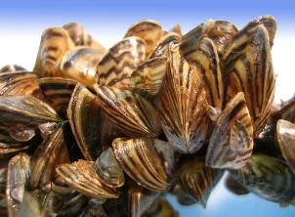
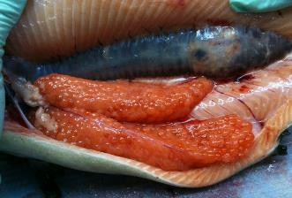
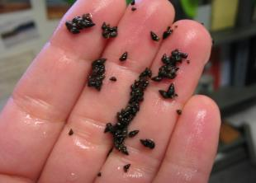
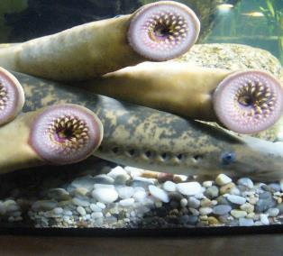
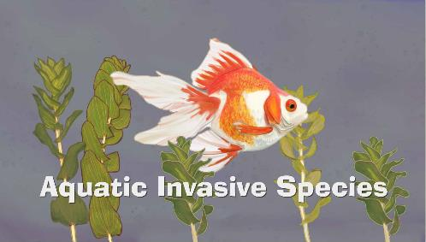
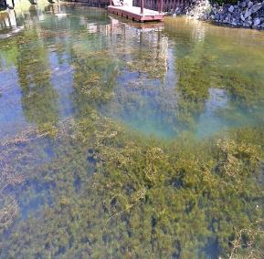
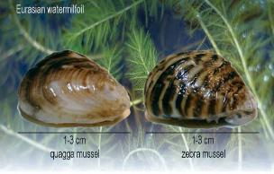
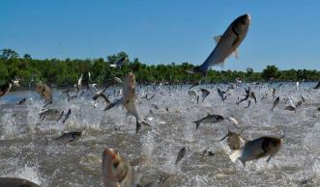
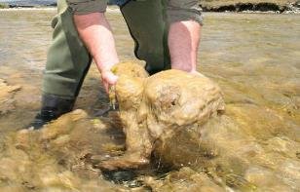
Biosecurity In Fish Hatcheries
Tom Tighe-Mora National Fish Hatchery

Slide 2
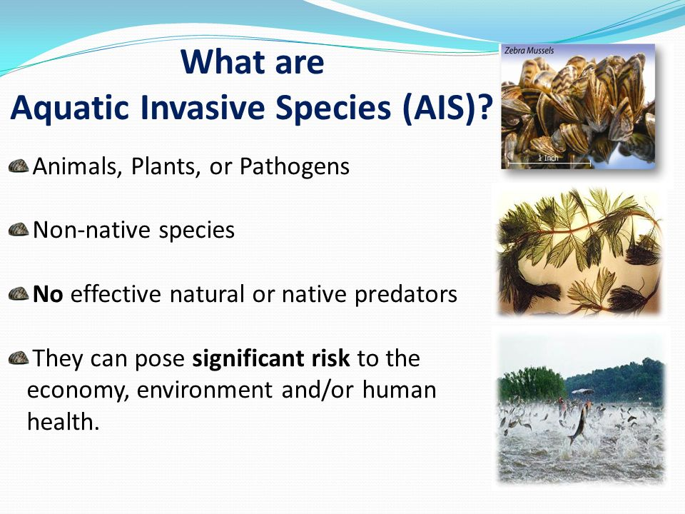

Slide 3
THE LIST AFFECTING HATCHERIES
Fish Disease (Bacteria, Virus, Parasites)
BKD - (Renibacterium salmoninarum)
IHNV - (Infectious hematopoietic necrosis virus)
IPNV - (Infectious pancreatic necrosis virus)
VHSV - (Viral hemorrhagic septicemia virus)
Furunculosis - (Aeromonas salmonicida)
Enteric redmouth - (Yersinia ruckeri)
Whirling disease - (Myxobolus cerebralis)
Coldwater Disease - (Flexibacter psychrophilus)
Fish Parasites – Internal and external
Aquatic Invasive Species
New Zealand Mud Snails
Quagga and Zebra Mussels
Other Land and Water Based AIS-List Constantly Changing

Slide 4
AIS/PATHOGEN MONITORING
FISH HATCHERIES
Difficult to predict where an invasion will occur, which species will invade, or the consequences of the invasion
Monitor constantly so efforts can be to prevent spread
Invasive species commonly spread by humans through trains, planes, ships and vehicles
Hatchery activities potential of spreading AIS between hatcheries, between water bodies and across state lines through fish/egg stocking

Slide 5
Potential AIS/Pathogen Effects on Hatcheries
Impact Operations by clogging pipes, aeration devices, screens and encrusting equipment.
May spread to other hatcheries, or into the environment by stocking / shipping fish and eggs
May pose catastrophic losses to fish populations

Slide 6

How do we prevent this?
Biosecurity!

Slide 7

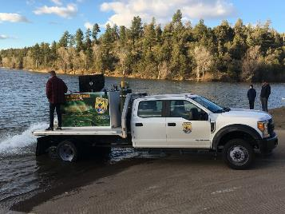
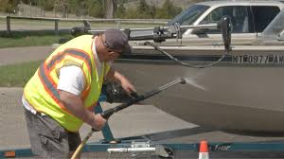

HATCHERY OUTSIDE BIOSECURITY
Weirs
Barriers
Covered Water Sources
Bird Netting / Roof over ponds
Fish Health Inspections
Disinfection of all equipment-trucks and stocking hoses

Slide 8
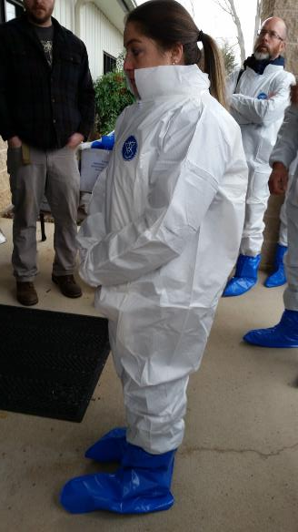
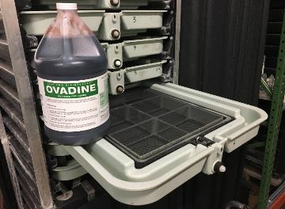
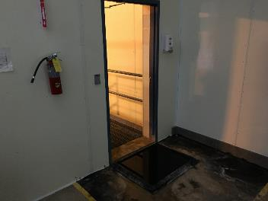
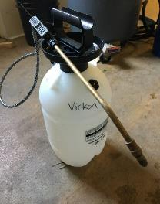
HATCHERY INSIDE BIOSECURITY
Prevention is key to Biosecurity. Don’t bring it into your facility!
Chemically disinfect equipment, eggs and human bodies

Slide 9
Good Practices
A written plan and training program
Good organization
Separate Nets, buckets, brooms for rearing containers
Foot baths for doorways
Cover and exclude predators
Can at least minimize exposure

Slide 10
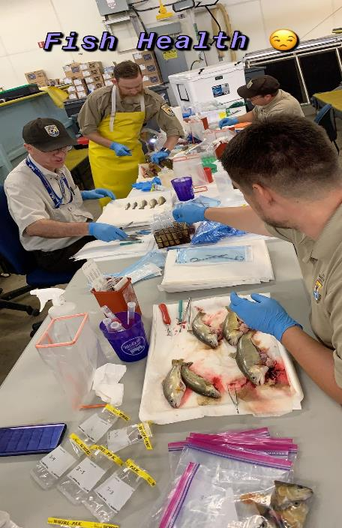
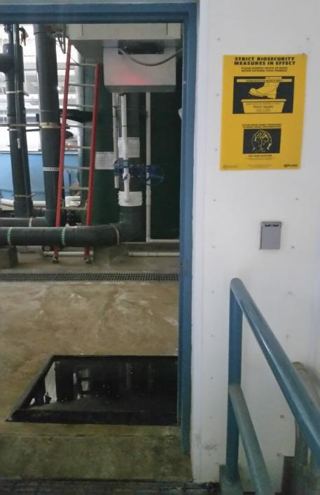

Slide 11
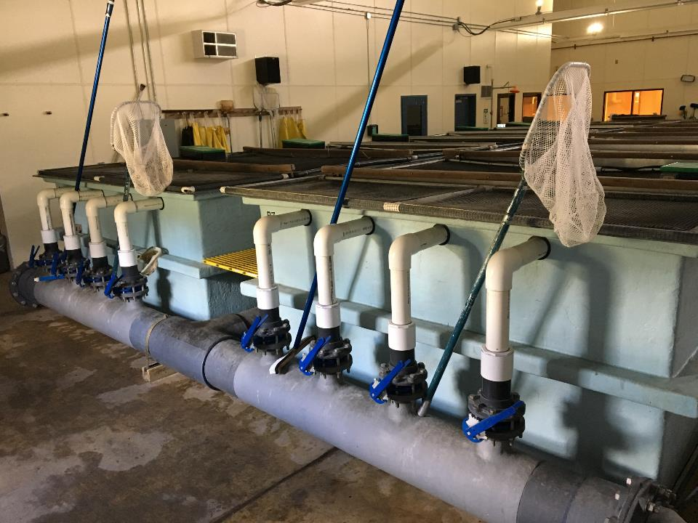

Slide 12
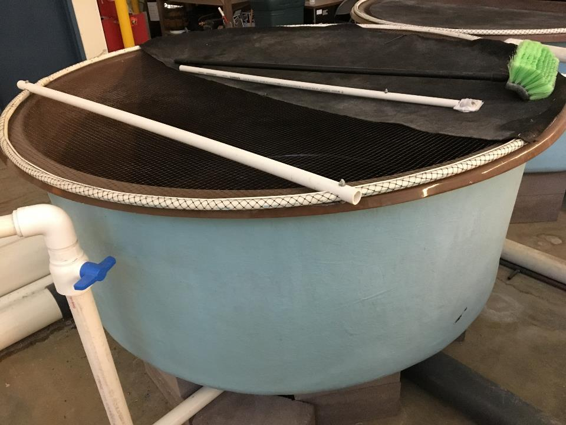

Slide 13
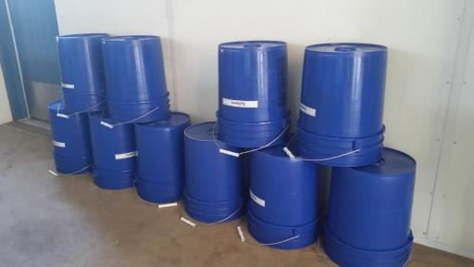
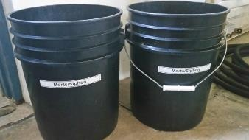
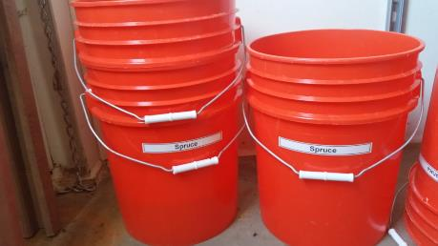
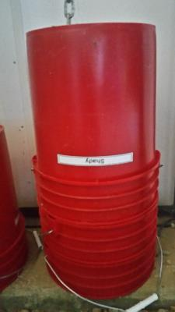
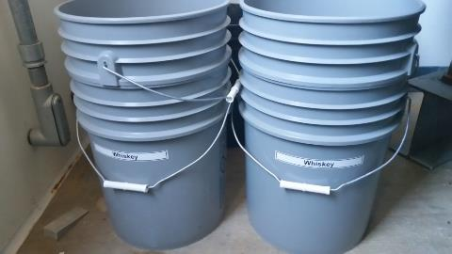
Get some Color-Coded Buckets

Slide 14
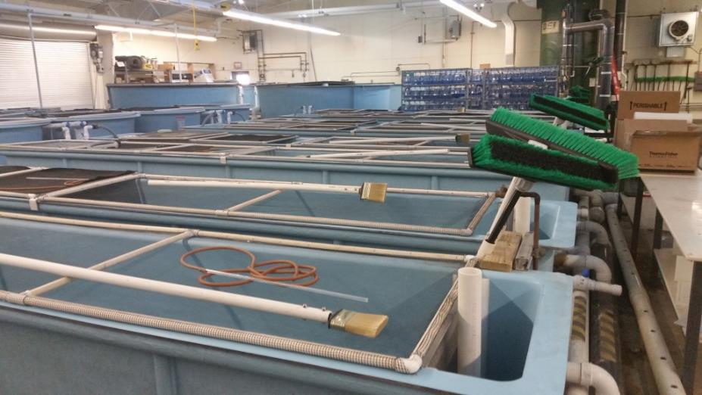
Keep it Simple!

Slide 15
HACCP
Hazard Analysis Critical Control Point Plan
Every hatchery should have HACCP Plans
Recommended to have HACCP Plans for every critical stage of fish development at hatchery:
-Broodstock, spawning and egg care, fry management, wild fish transfer and fish stocking
**Where can we stop the particular problem or pathogen from causing a problem for the finished product?
  In a hatchery, that usually starts with the water source!!

Slide 16
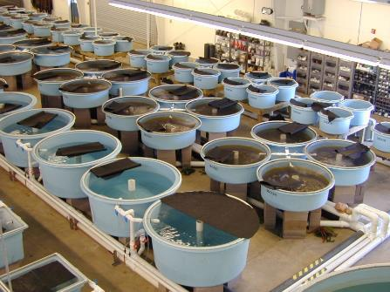
Fully Recirculating System
Main Components:
Culture Tanks
Drum Filtration
Pump Bank
Bio-Filtration
Gas Conditioning
UV Sterilization
Re-Oxygenation
5% make-up water
Culture Tanks

Slide 17
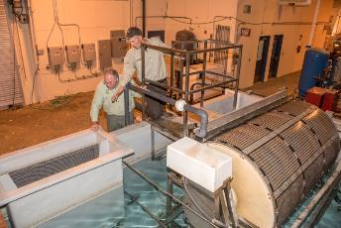
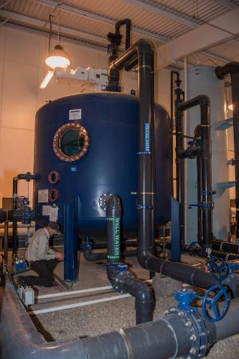
Fully Recirculating System
Stripping Tower
Gas Conditioning
Bio Filter
Drum Filter

Slide 18
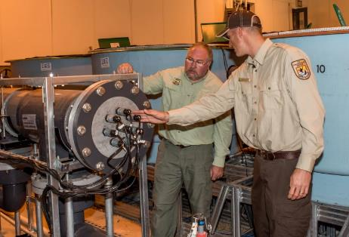
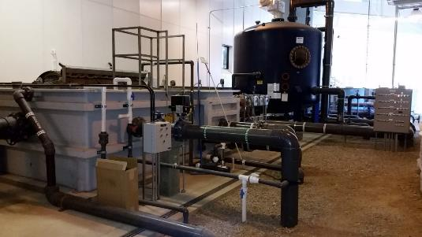
Fully Recirculating System
UV Sterilization

Slide 19
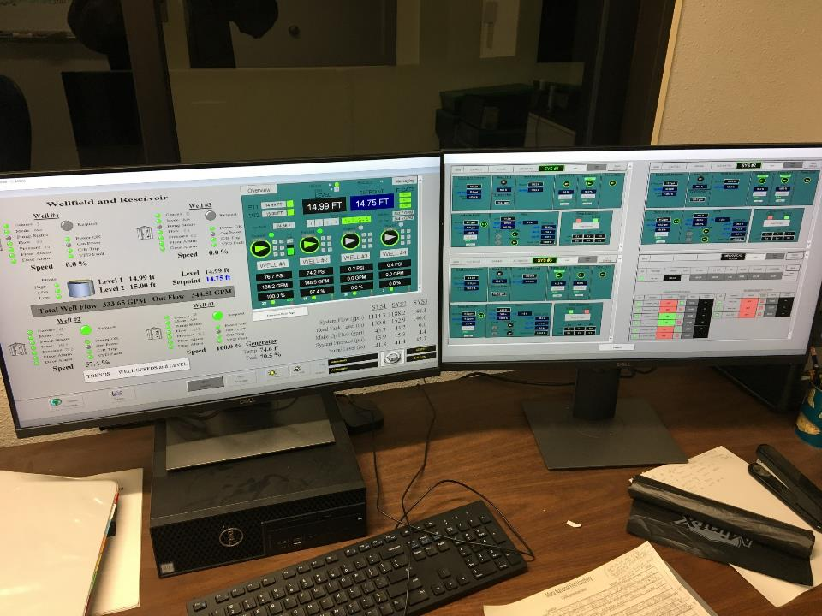

Slide 20
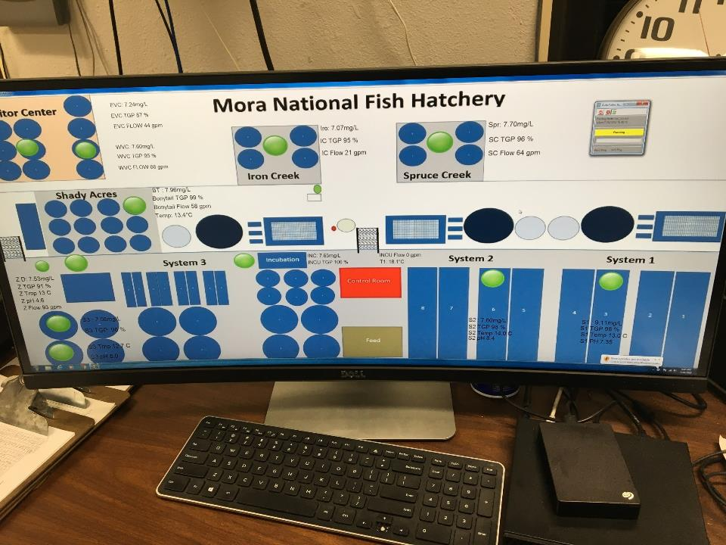

Slide 21
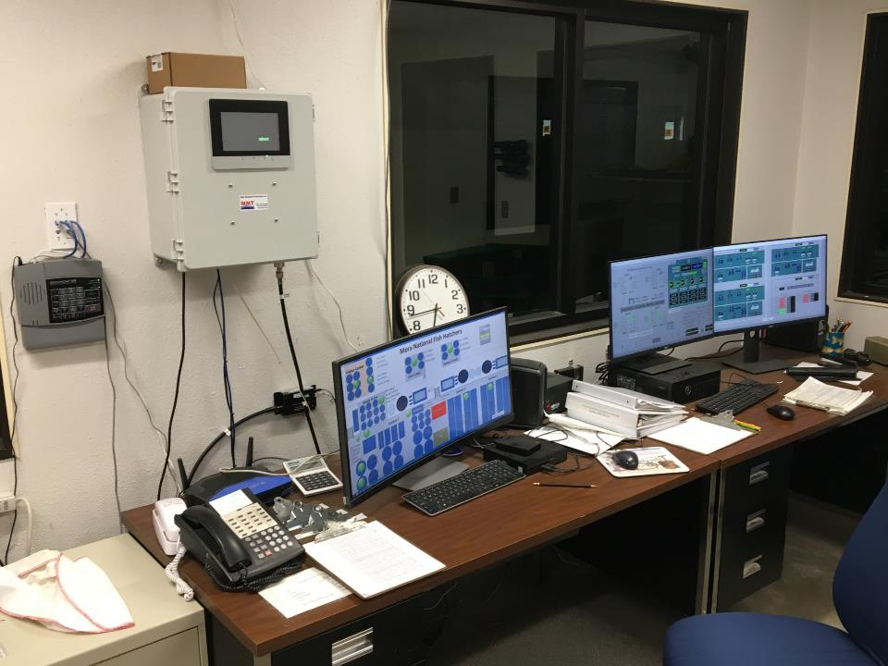

Slide 22
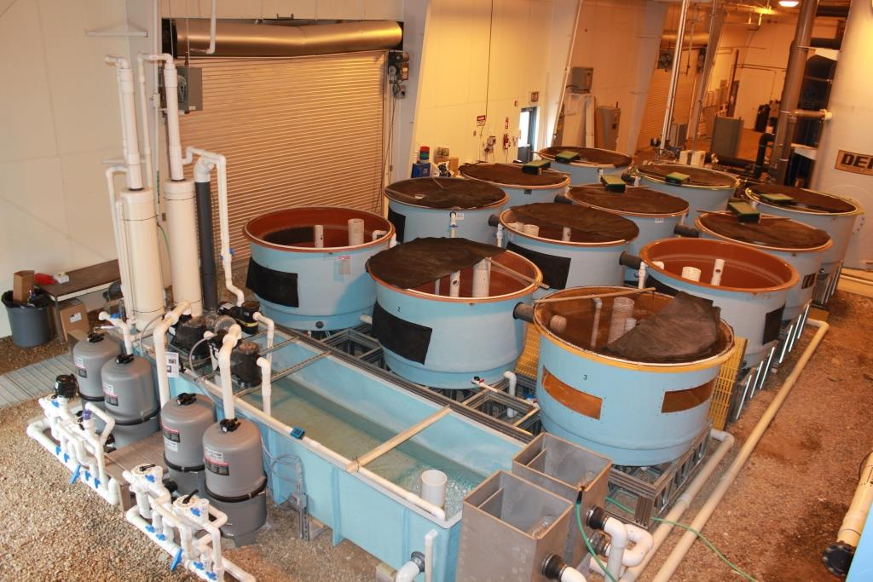

Slide 23
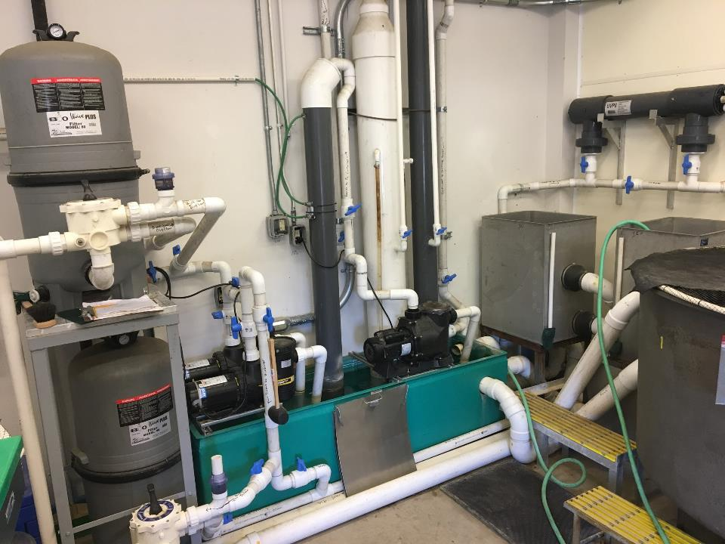
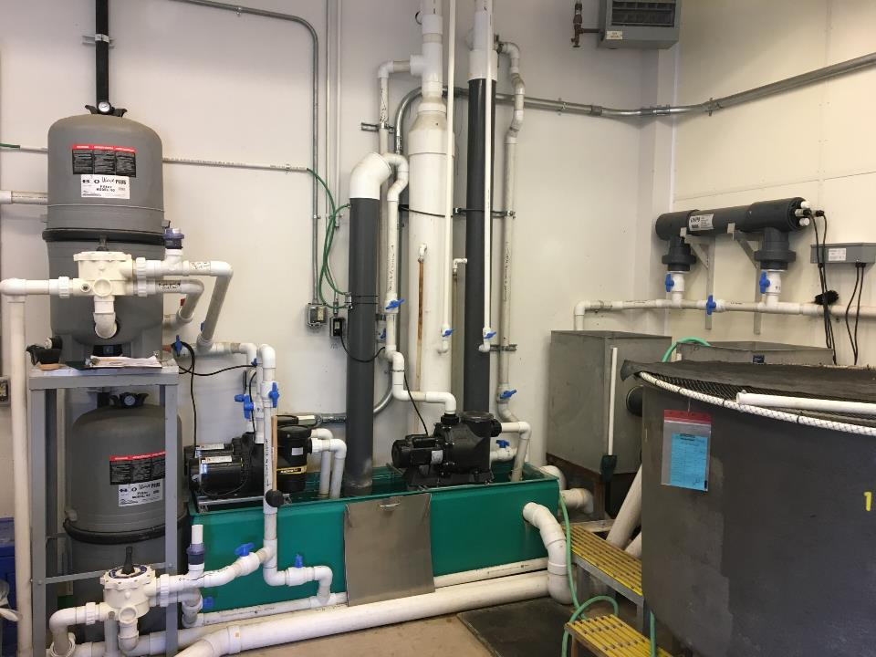
Bio filters
UV Sterilization
Gas Conditioning
Pump Bank
Microscreens
Sump

Slide 24
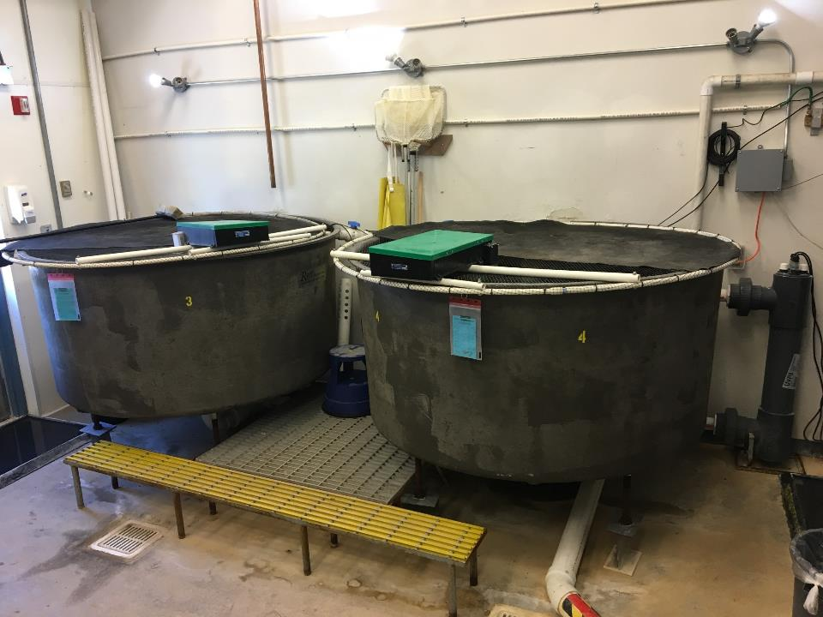
Four-625 Gallon Round Tanks-10 GPM flow

Slide 26
PVC Parts List

Slide 27
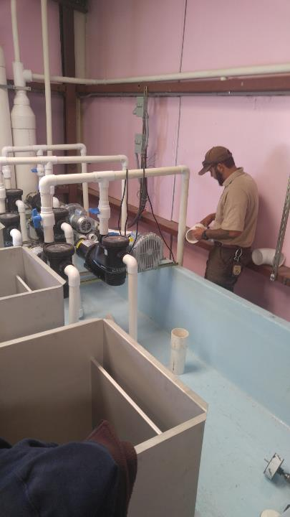
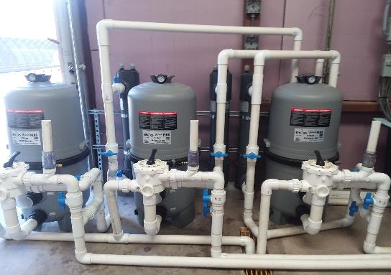
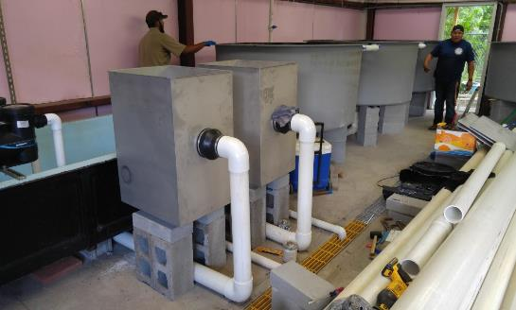
Mescalero Fish Hatchery RAS Project

Slide 28
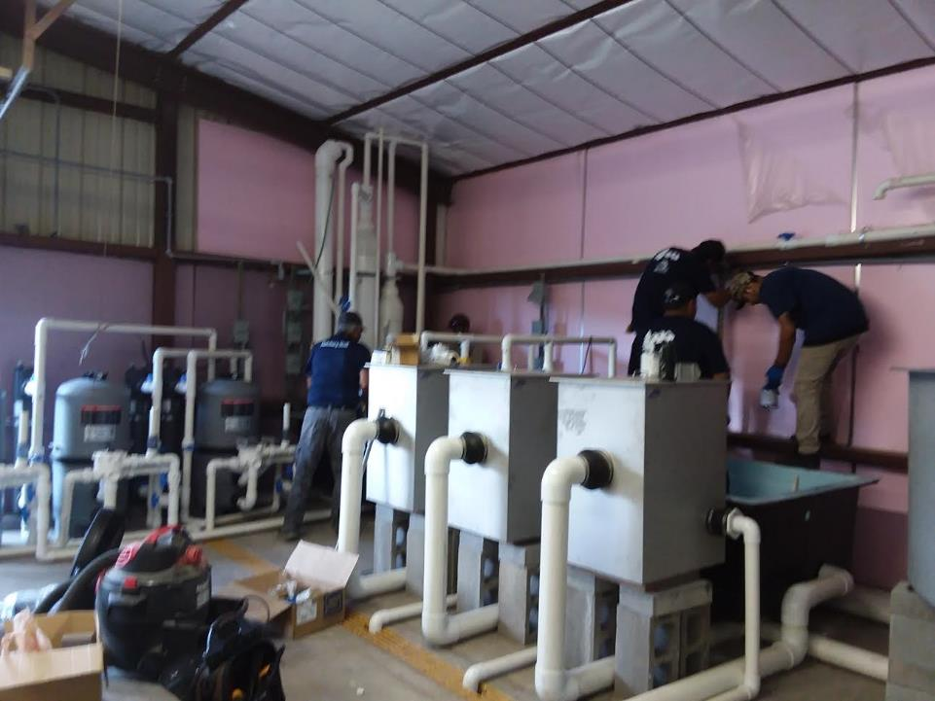

Slide 29
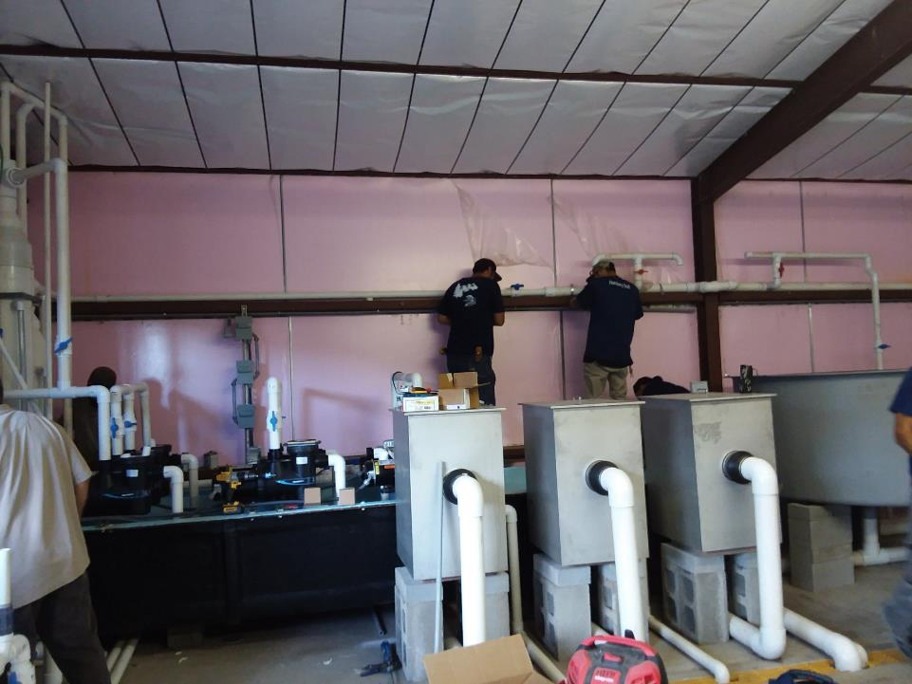

Slide 30
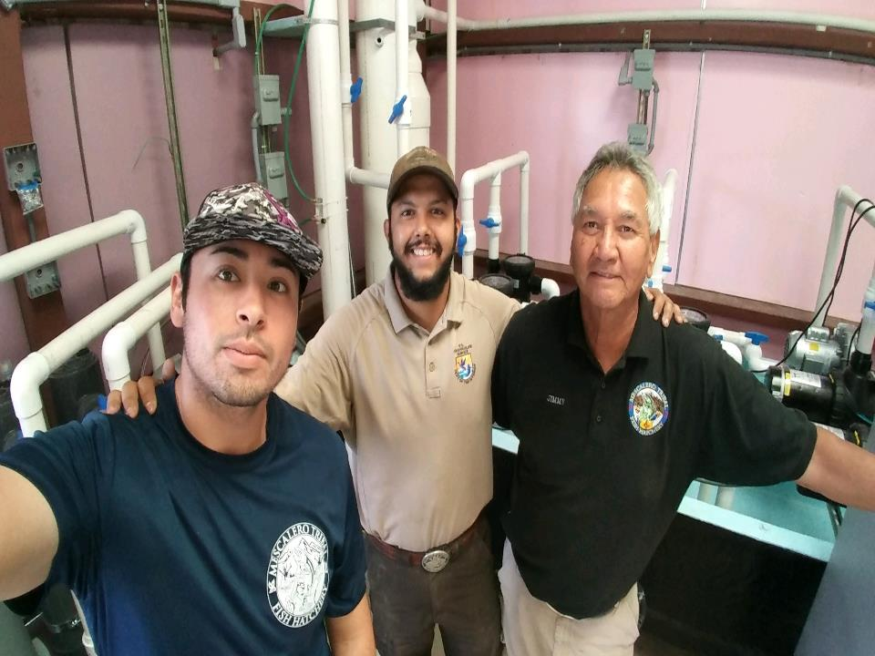

Slide 31
7500 gallon rearing space (12 tanks) isolation Recirculating Aquaculture System
Item | Category | Qty | Cost | Total | Comment
YSI 5500 | Alarm | 1 | $ 4,500.00 | $ 4,500.00 | YSI
Pro ODO Optical DO | Alarm | 3 | $ 680.00 | $ 2,040.00 | YSI
George Fischer Signet Flow Meter 2" | Alarm | 3 | $ 890.00 | $ 2,670.00 | YSI
TGP Probe | Alarm | 1 | $ 680.00 | $ 680.00 | YSI
BioWave Plus 60 Biofilter | Biofilter | 3 | $ 2,399.00 | $ 7,197.00 | Wlim Corporation
Amalgam Series UVP 2 Lamp | UV System | 3 | $ 3,579.00 | $ 10,737.00 | Wlim Corporation - One RAS
Jacuzzi Magnum Force Pump (1hp) | Pumps | 7 | $ 400.00 | $ 2,800.00 | 4 Online (1 spare plumbed in, 2 spares on shelf)
PVC (see additional sheet) | PVC | 1 | $ 5,000.00 | $ 5,000.00 | 20 Feet for two degassers
36" x 72" round tanks with Naturalistic Inlay | Tanks | 12 | $ 2,595.00 | $ 31,140.00 | Reiff Manufacturing
Freight for tanks | Tanks |  |  | $ 3,420.00
Unistrut for pumps, degassers, etc. | Unistrut | 40 | $ 10.00 | $ 400.00 | Lowes
Unistrut Bolts | Unistrut | 100 | $ 1.00 | $ 100.00 | Lowes
Cinder Blocks |  | 180 | $ 3.00 | $ 540.00 | Lowes
Paving Blocks (3 1/2") |  | 180 | $ 1.00 | $ 180.00 | Lowes

Slide 32
O2 Regulator, Ki Flowmeter, O2 Line | O2 System | 6 | $ 250.00 | $ 1,500.00 | Eagar (QQ769 and QQ760)
Belt Feeders |  | 12 | $ 415.00 | $ 4,980.00 | Eagar (LL9812)
Bird Netting |  | 1 | $ 201.35 | $ 201.35 | Eagar (EE104) - Jump Screens
1/4" Oxygen Hose |  | 500 | $ 1.10 | $ 550.00 | Eagar (RR700) - For O2 system
1/4" T's |  | 24 | $ 1.59 | $ 38.16 | Eagar (QQ757)
5/16" Hose Clamps |  | 36 | $ 0.95 | $ 34.20 | Eagar (QQ736)
O2 Stones for Back-up system (12") | O2 System | 12 | $ 65.00 | $ 780.00 | Eagar (QQ705)
1/8" rivets |  | 400 | $ 0.10 | $ 40.00 | Lowes
1/4" x 2" SS bolts and Lock Nuts |  | 24 | $ 0.50 | $ 12.00 | Lowes
Sensaphone 400 Autodialer | Alarm | 1 | $ 497.69 | $ 497.69 | Pentair A2 pg 243
200 Micron Parabolic Screen Filter | Filter | 3 | $ 2,338.00 | $ 7,014.00 | Pentair 2873 pg 105
Sweetwater S41-A Regen Blower | Blower | 2 | $ 694.69 | $ 1,389.38 | Pentair (1 spare)
2" Uniseals |  | 24 | $ 4.69 | $ 112.56 | Pentair (U200)
4" Uniseals |  | 12 | $ 6.29 | $ 75.48 | Pentair (U300)
Electrical Supplies | Electrical | 1 | $ 1,500.00 | $ 1,500.00 | Local Vendor
 |  |  |  | $ 88,628.82

Slide 33
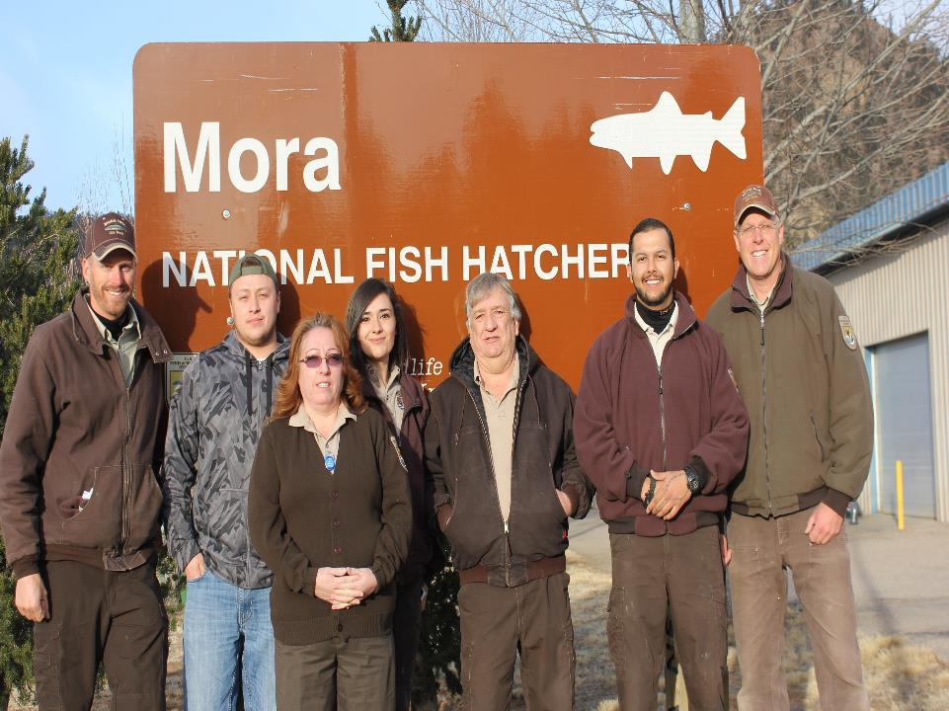
SOMETIMES….…STUFF JUST HAPPENS!

Slide 34
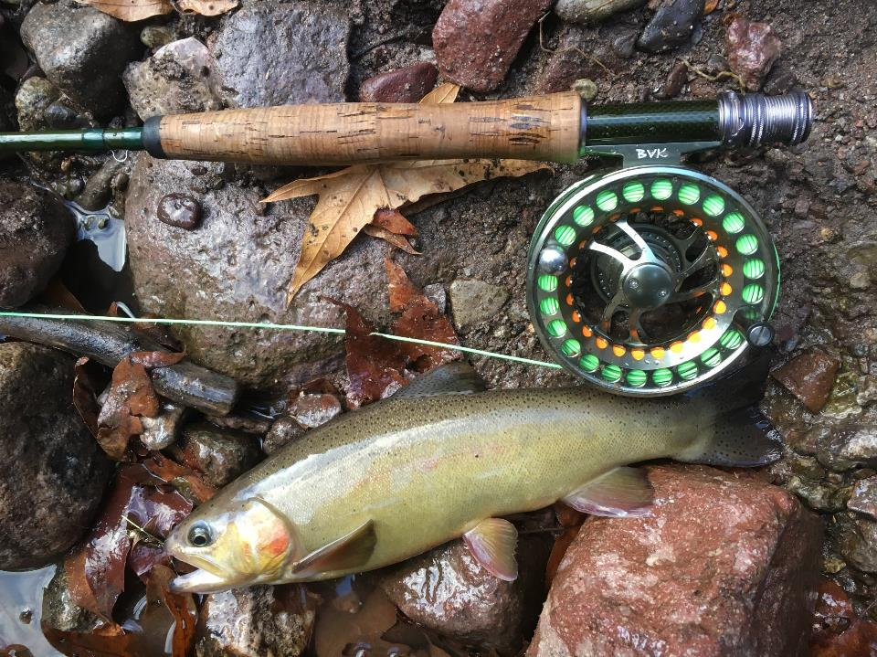
QUESTIONS?

